Slide 1

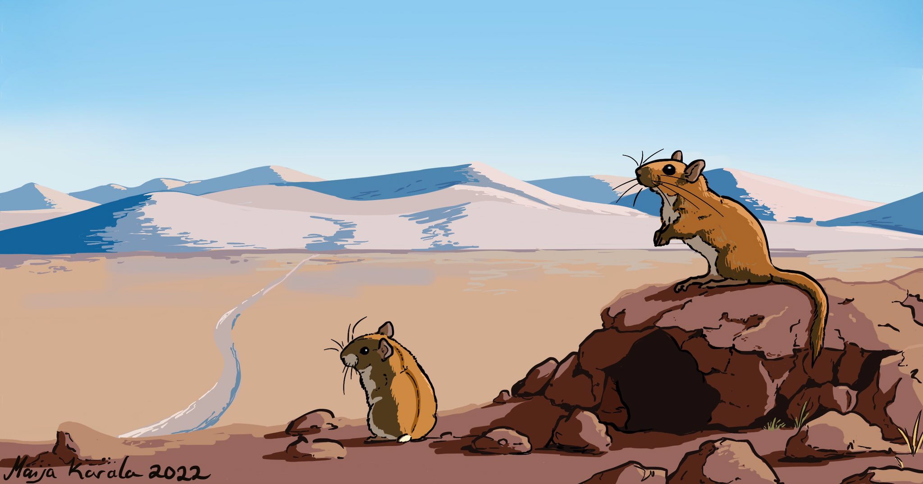
Modelling the evolution of metabolic phenotypes in terrestrial mammals

Slide 2





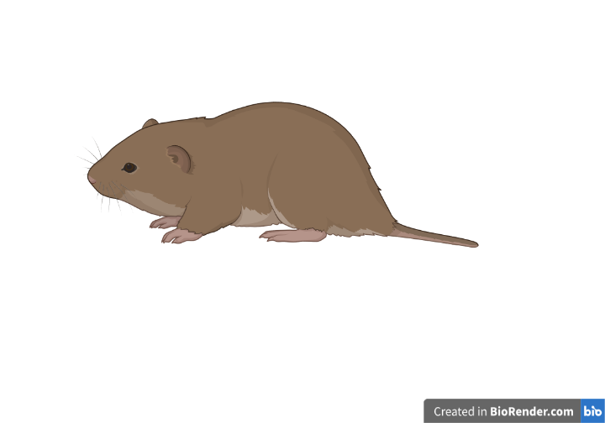



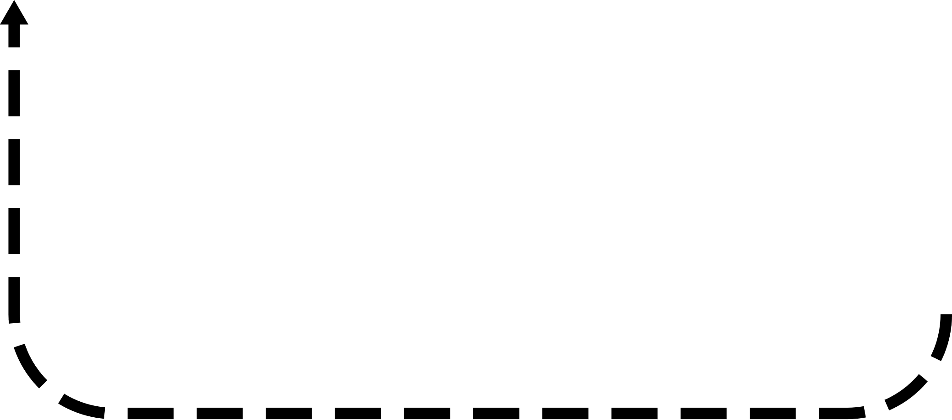





Energy budget model overview
Vole illustration from BioRender

Slide 3
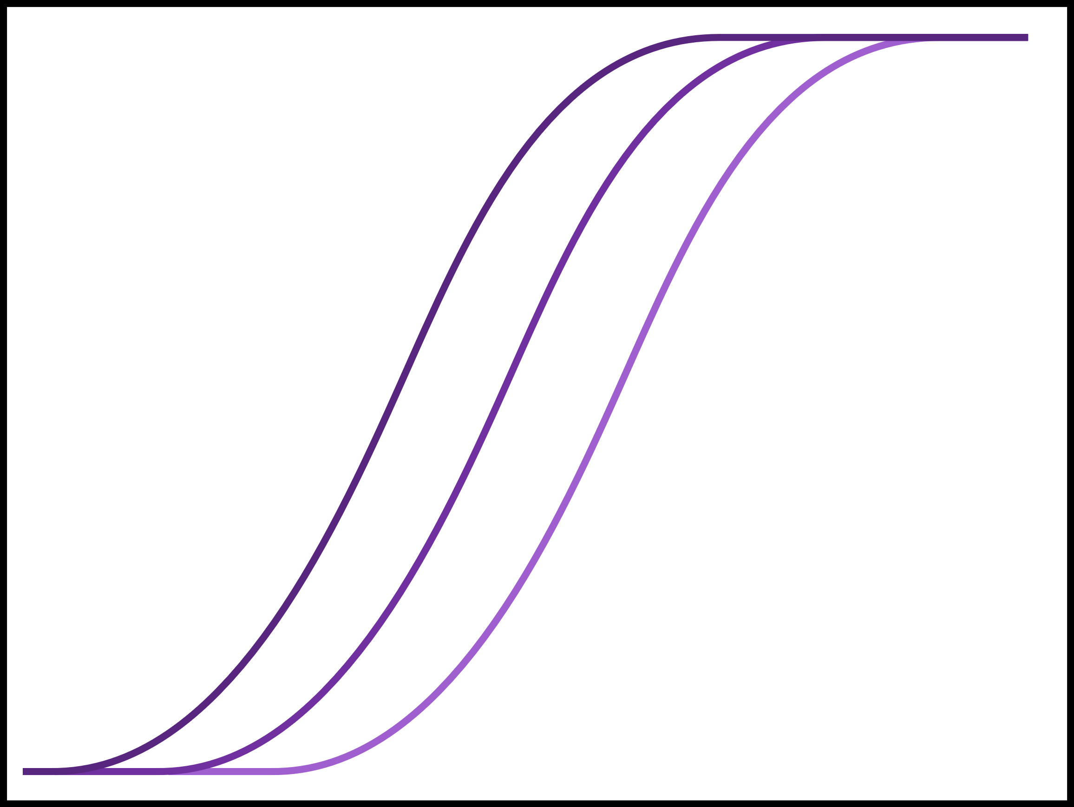
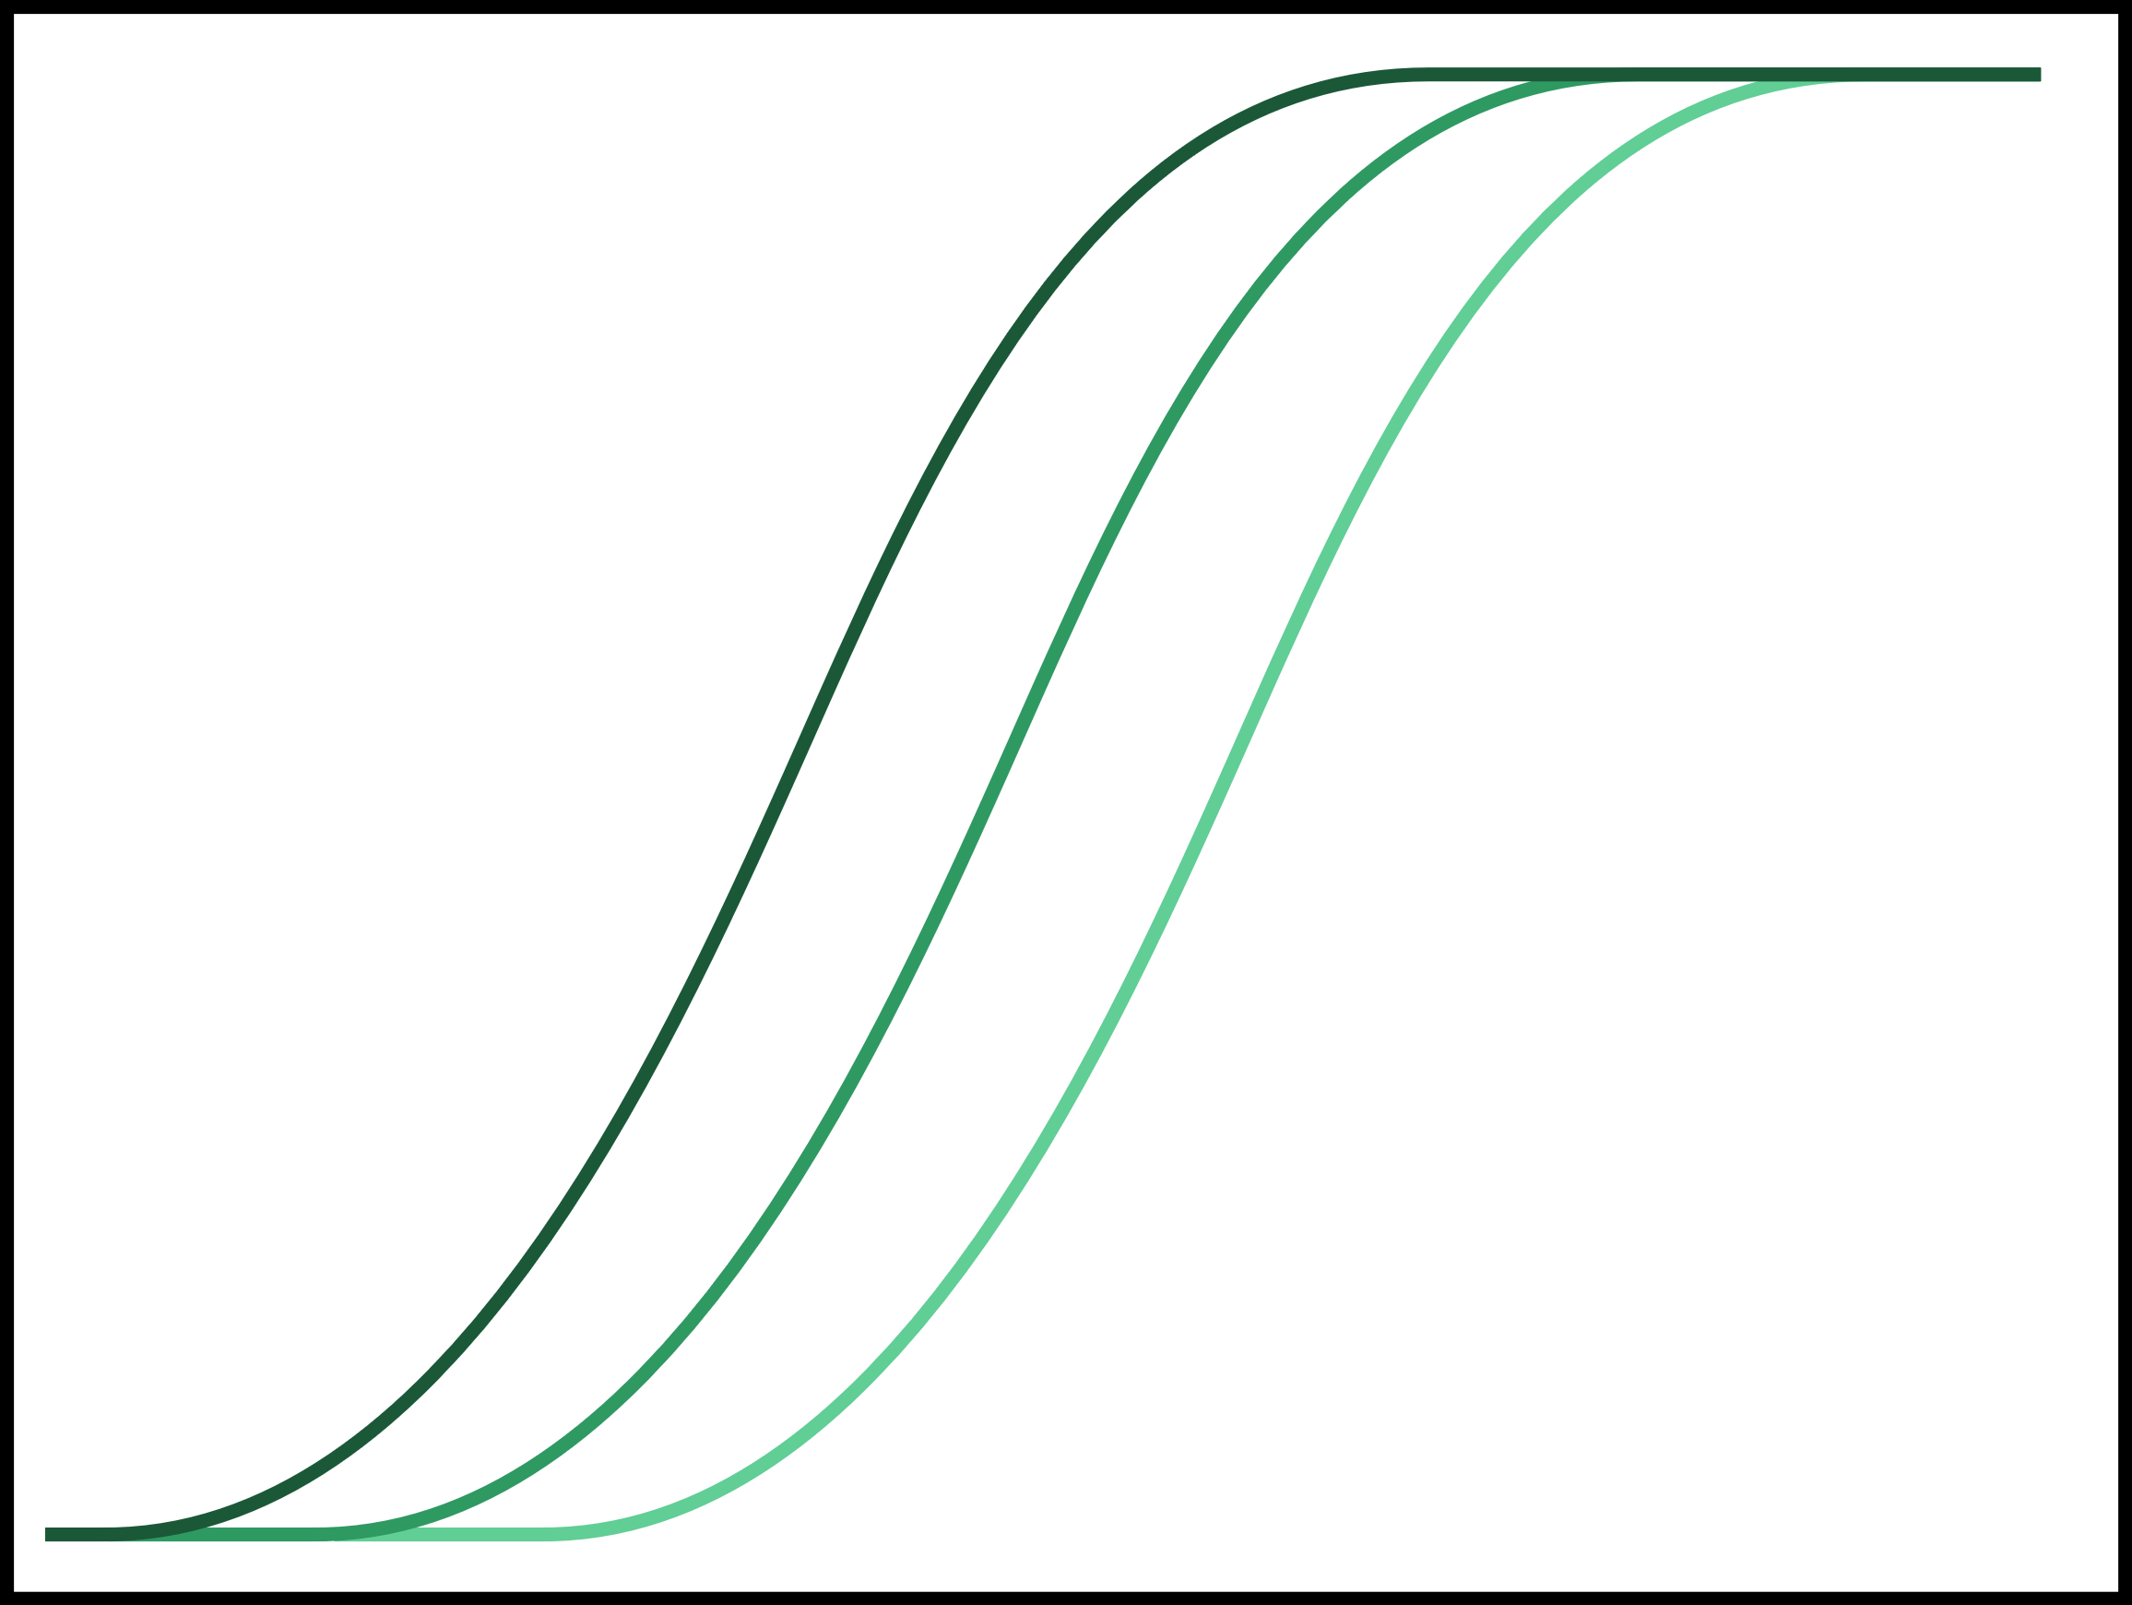
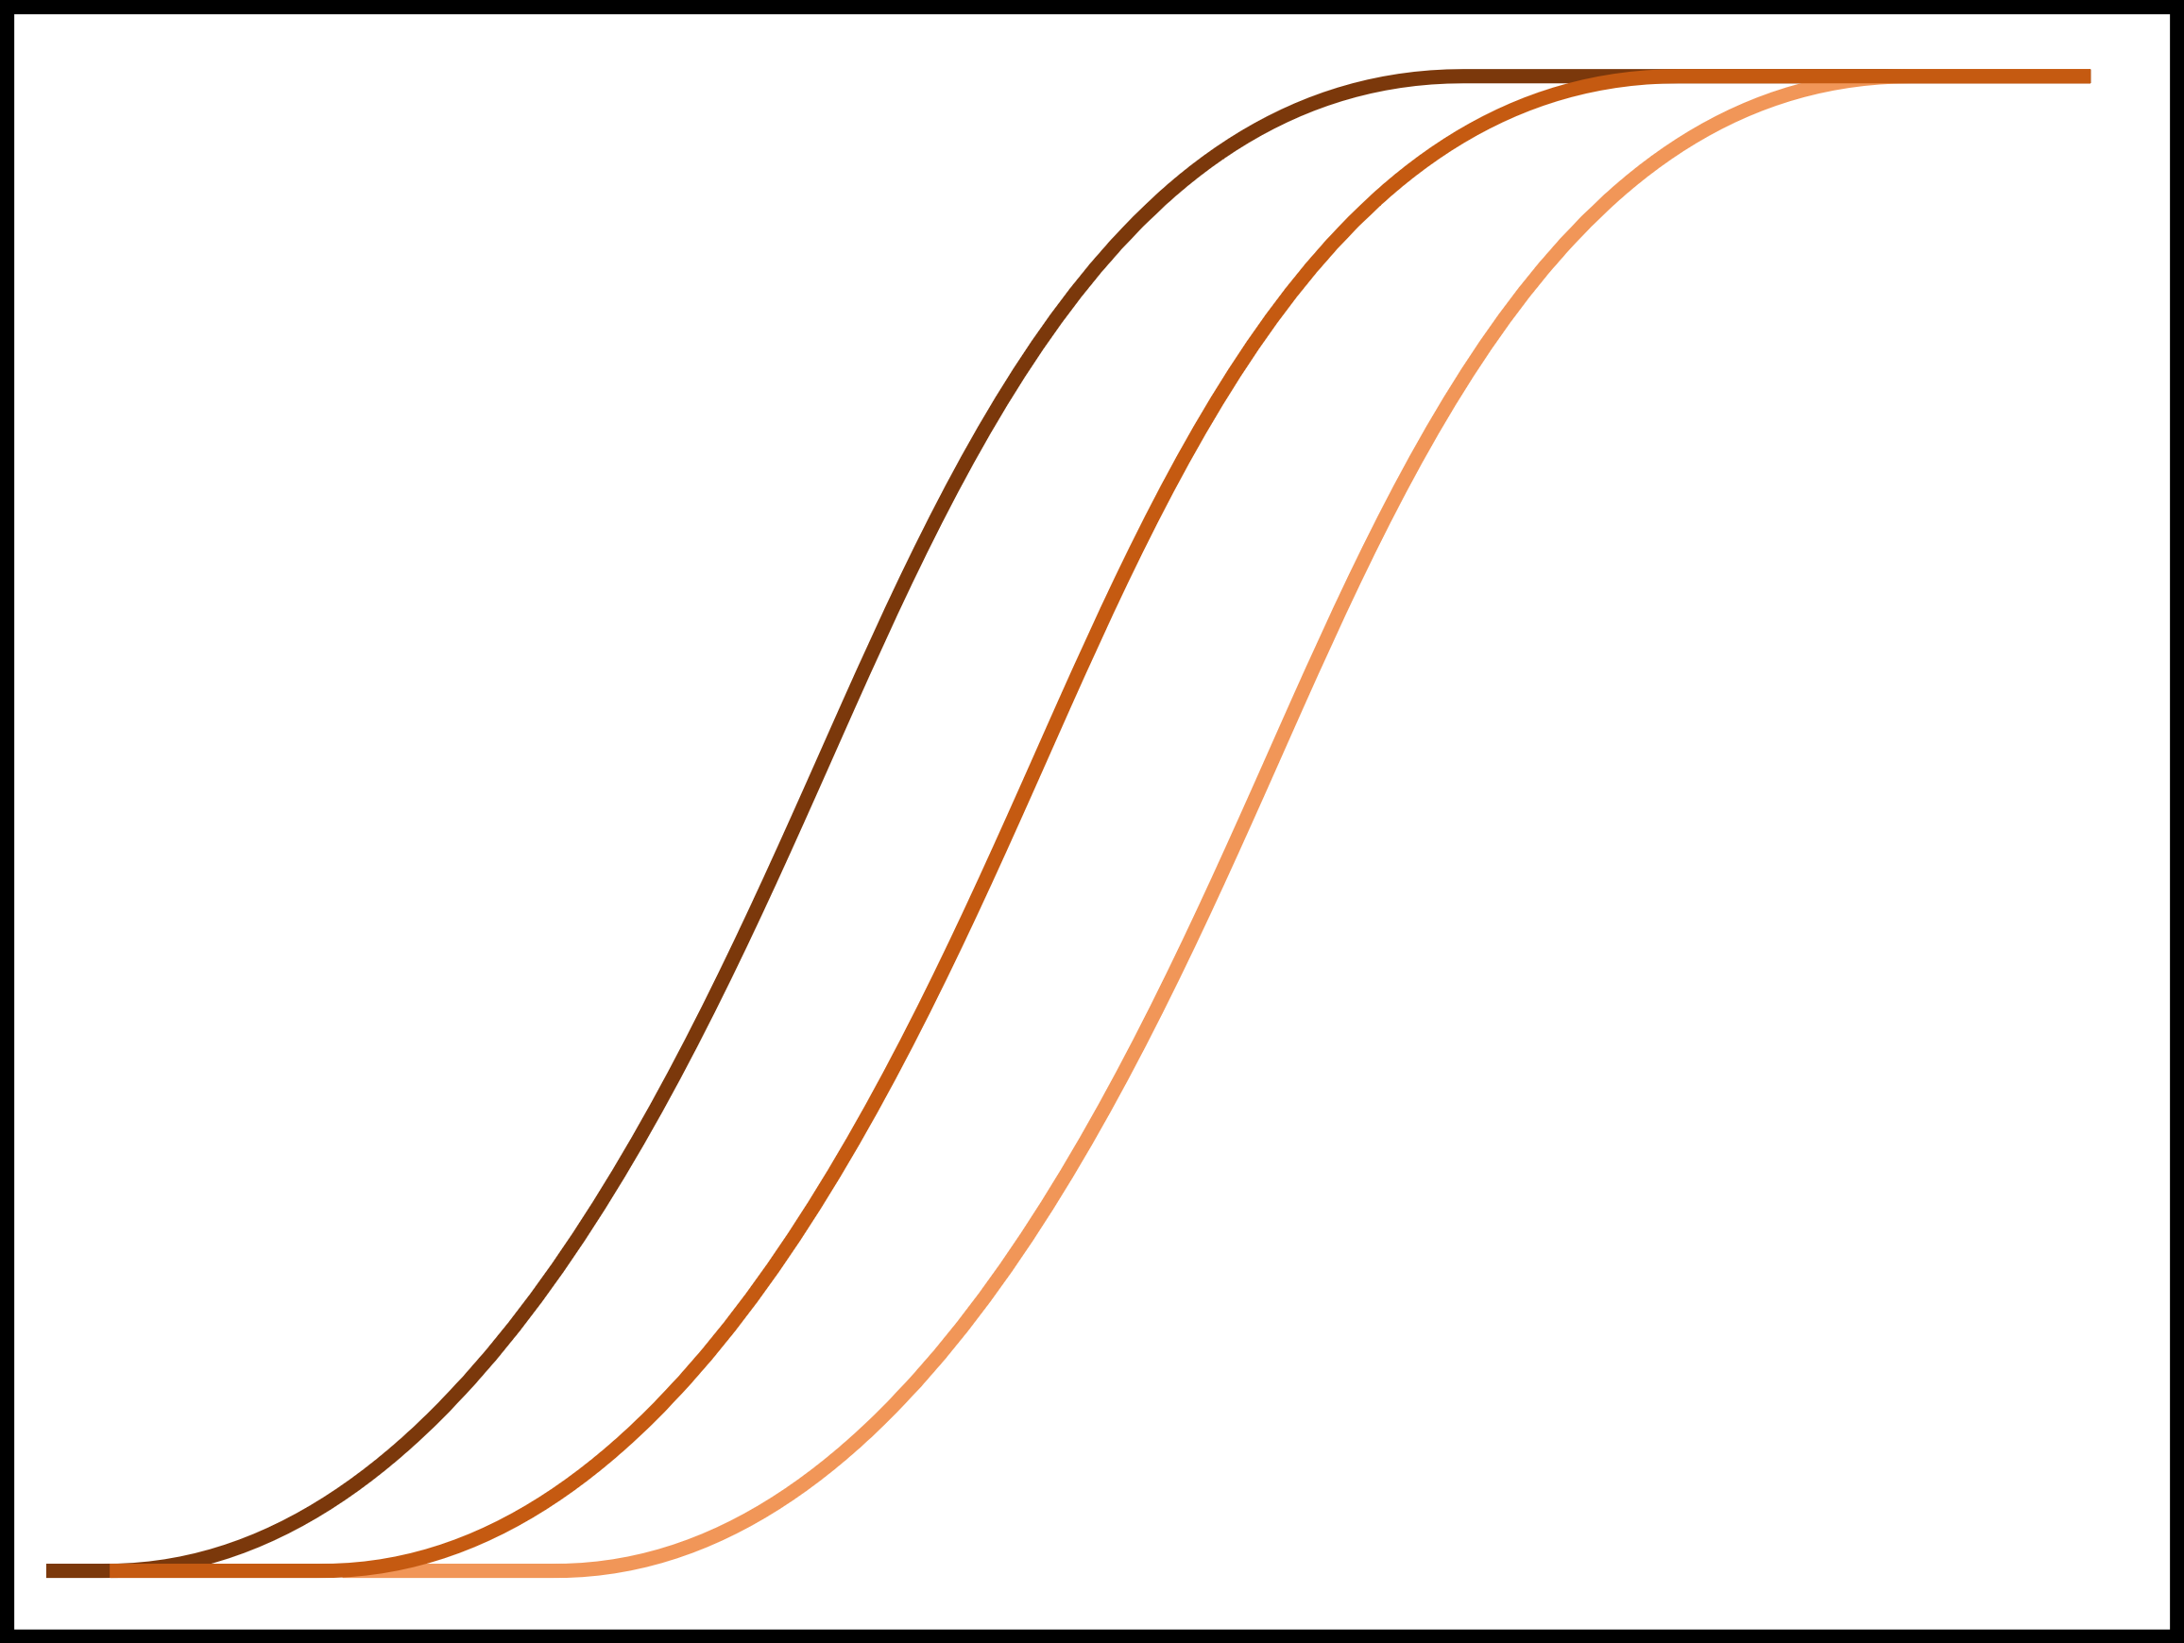
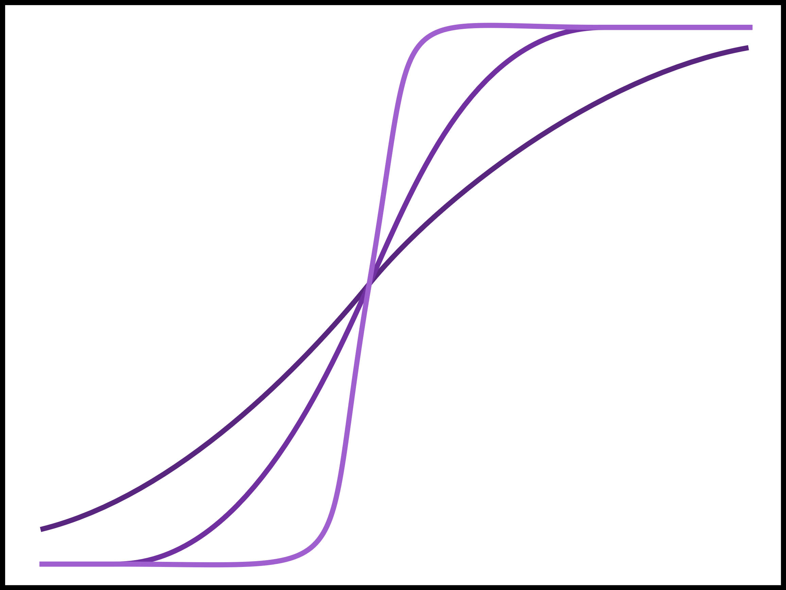
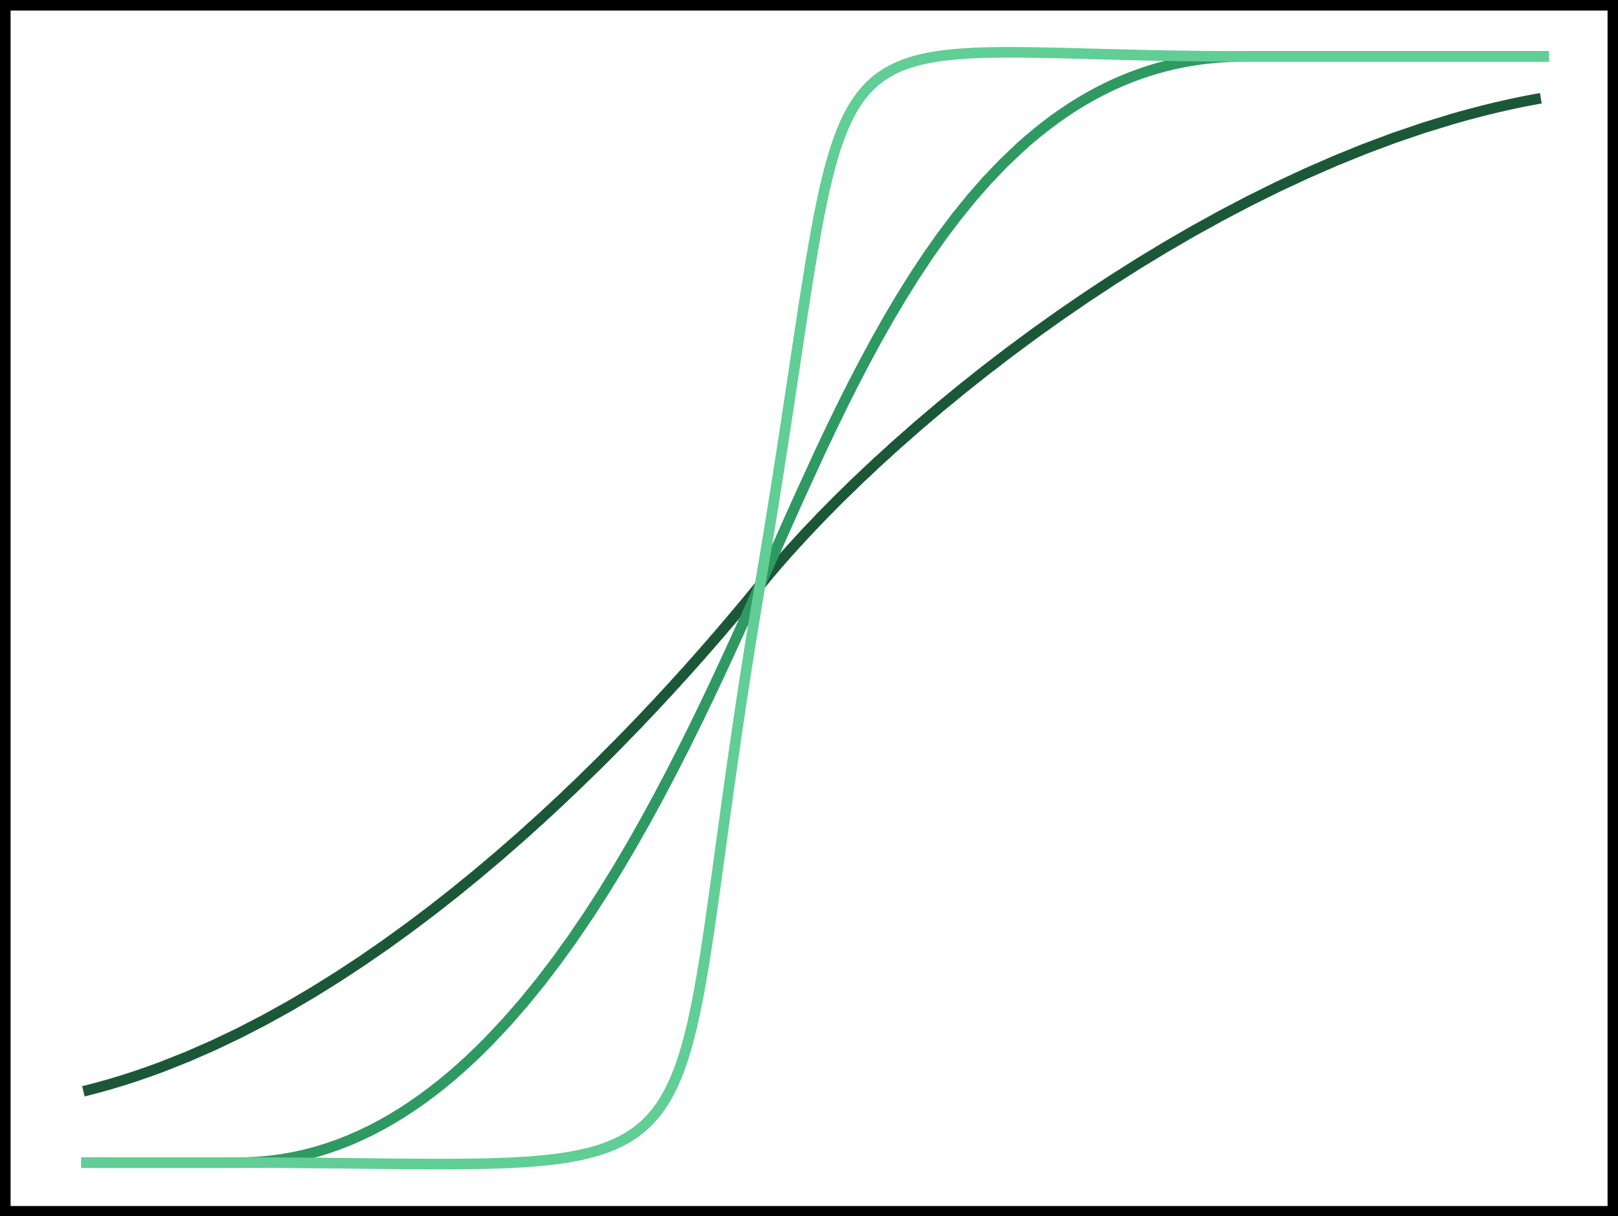
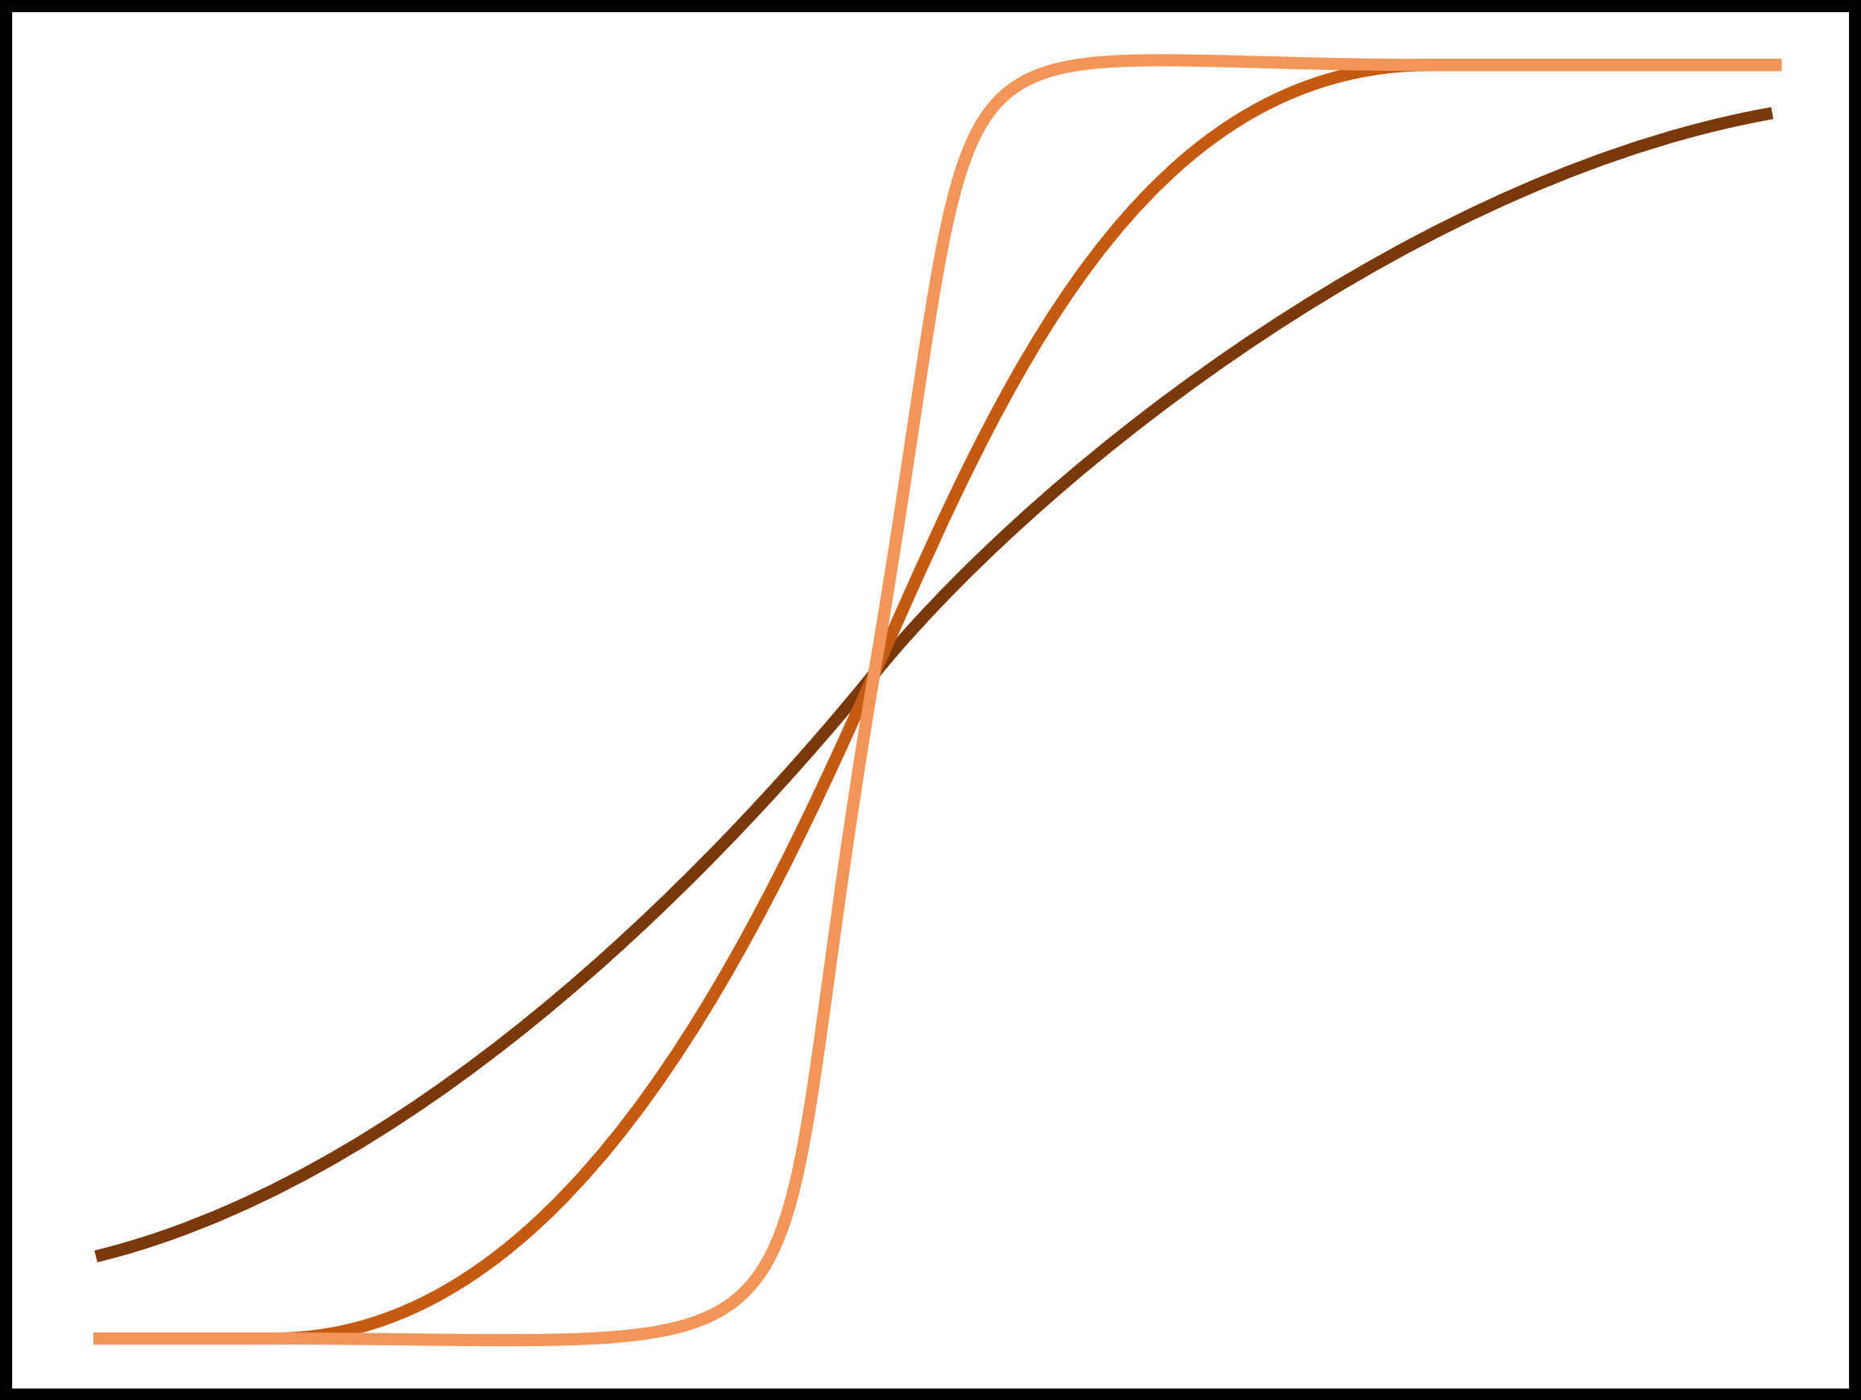
Calibration with ABC
10 parameters
Growth
Reproduction
Survival
Allocation %
Allocation %
Survival prob
Body fat %
Body fat %
Body fat %
Pregnancy & lactation
+ 2 modifiers for embryo and offspring survival
500,000 simulations (212,240 finished)
Results collected from simulation year 5
Uniform sampling with LHS
16 empirical patterns
Used the mean of the absolute scaled errors to assess fit

Slide 4


Calibration with ABC

Slide 5
Selection criteria
Applied a consistent threshold across all patterns
Selected cutoff which included the 50 best fits

Slide 6
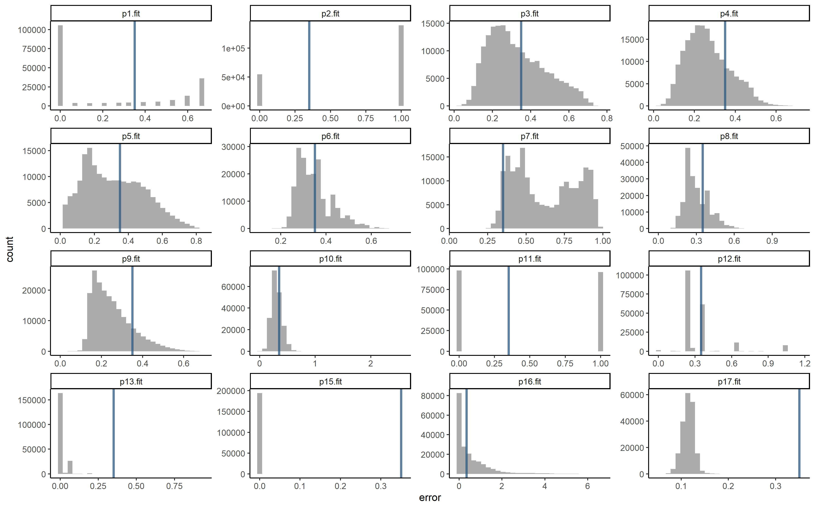
Selection criteria

Slide 7
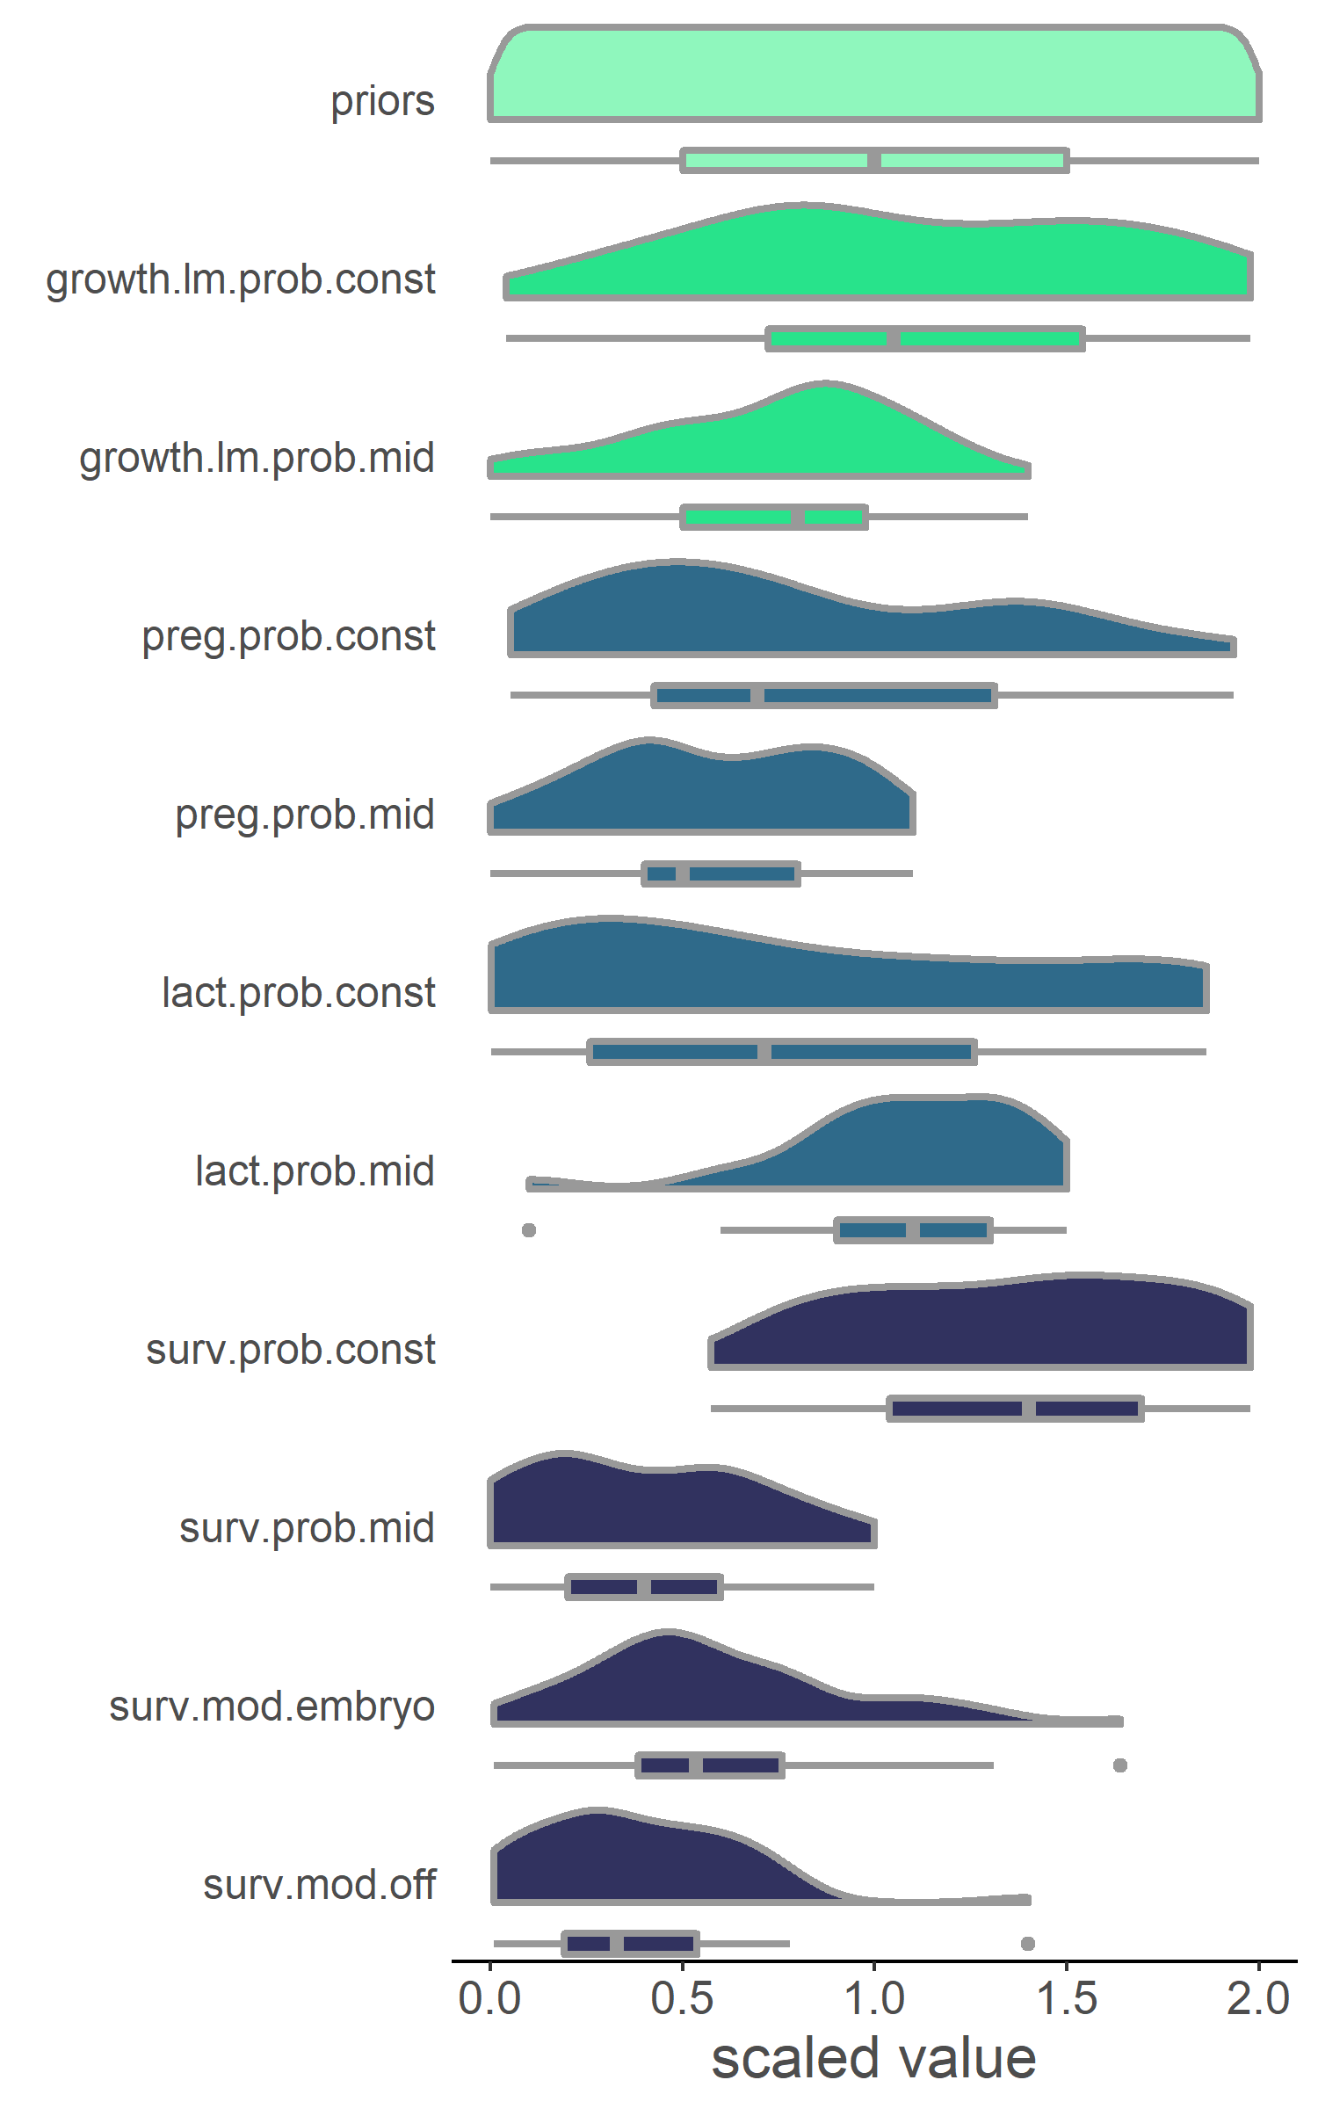


Priors and posteriors
Based on some exploring with what ranges resulted in simulations which would run to the end of the 5 year period

Slide 8
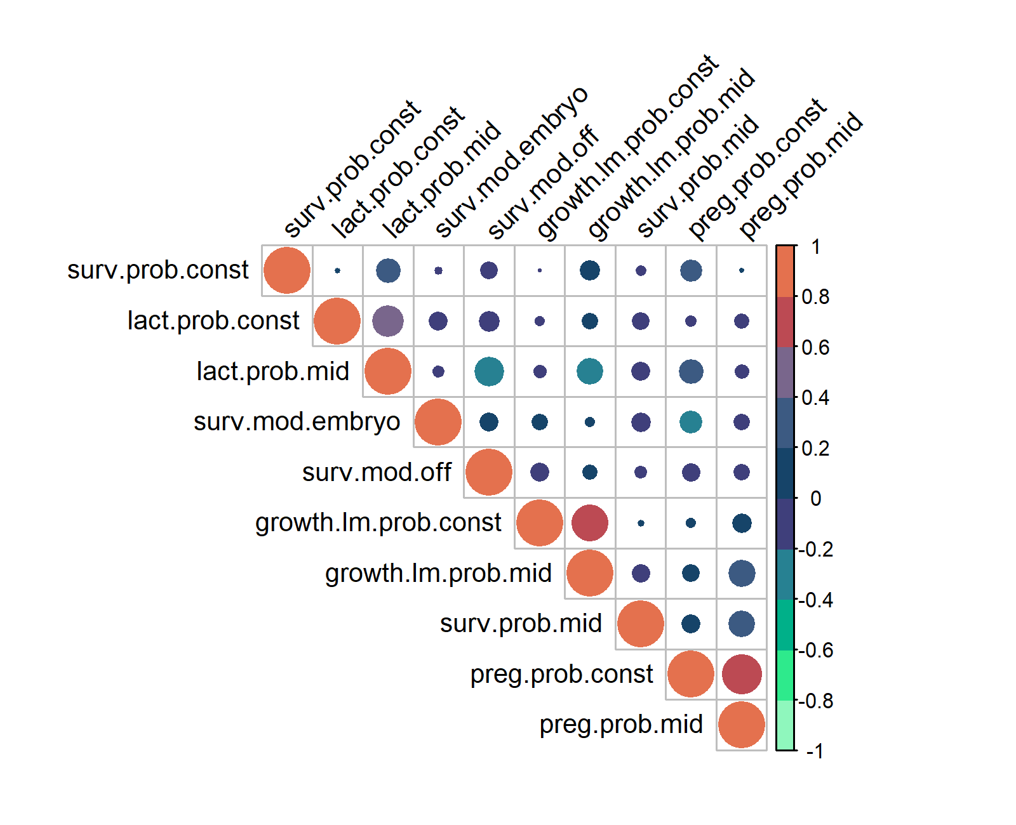
Priors and posteriors

Slide 9
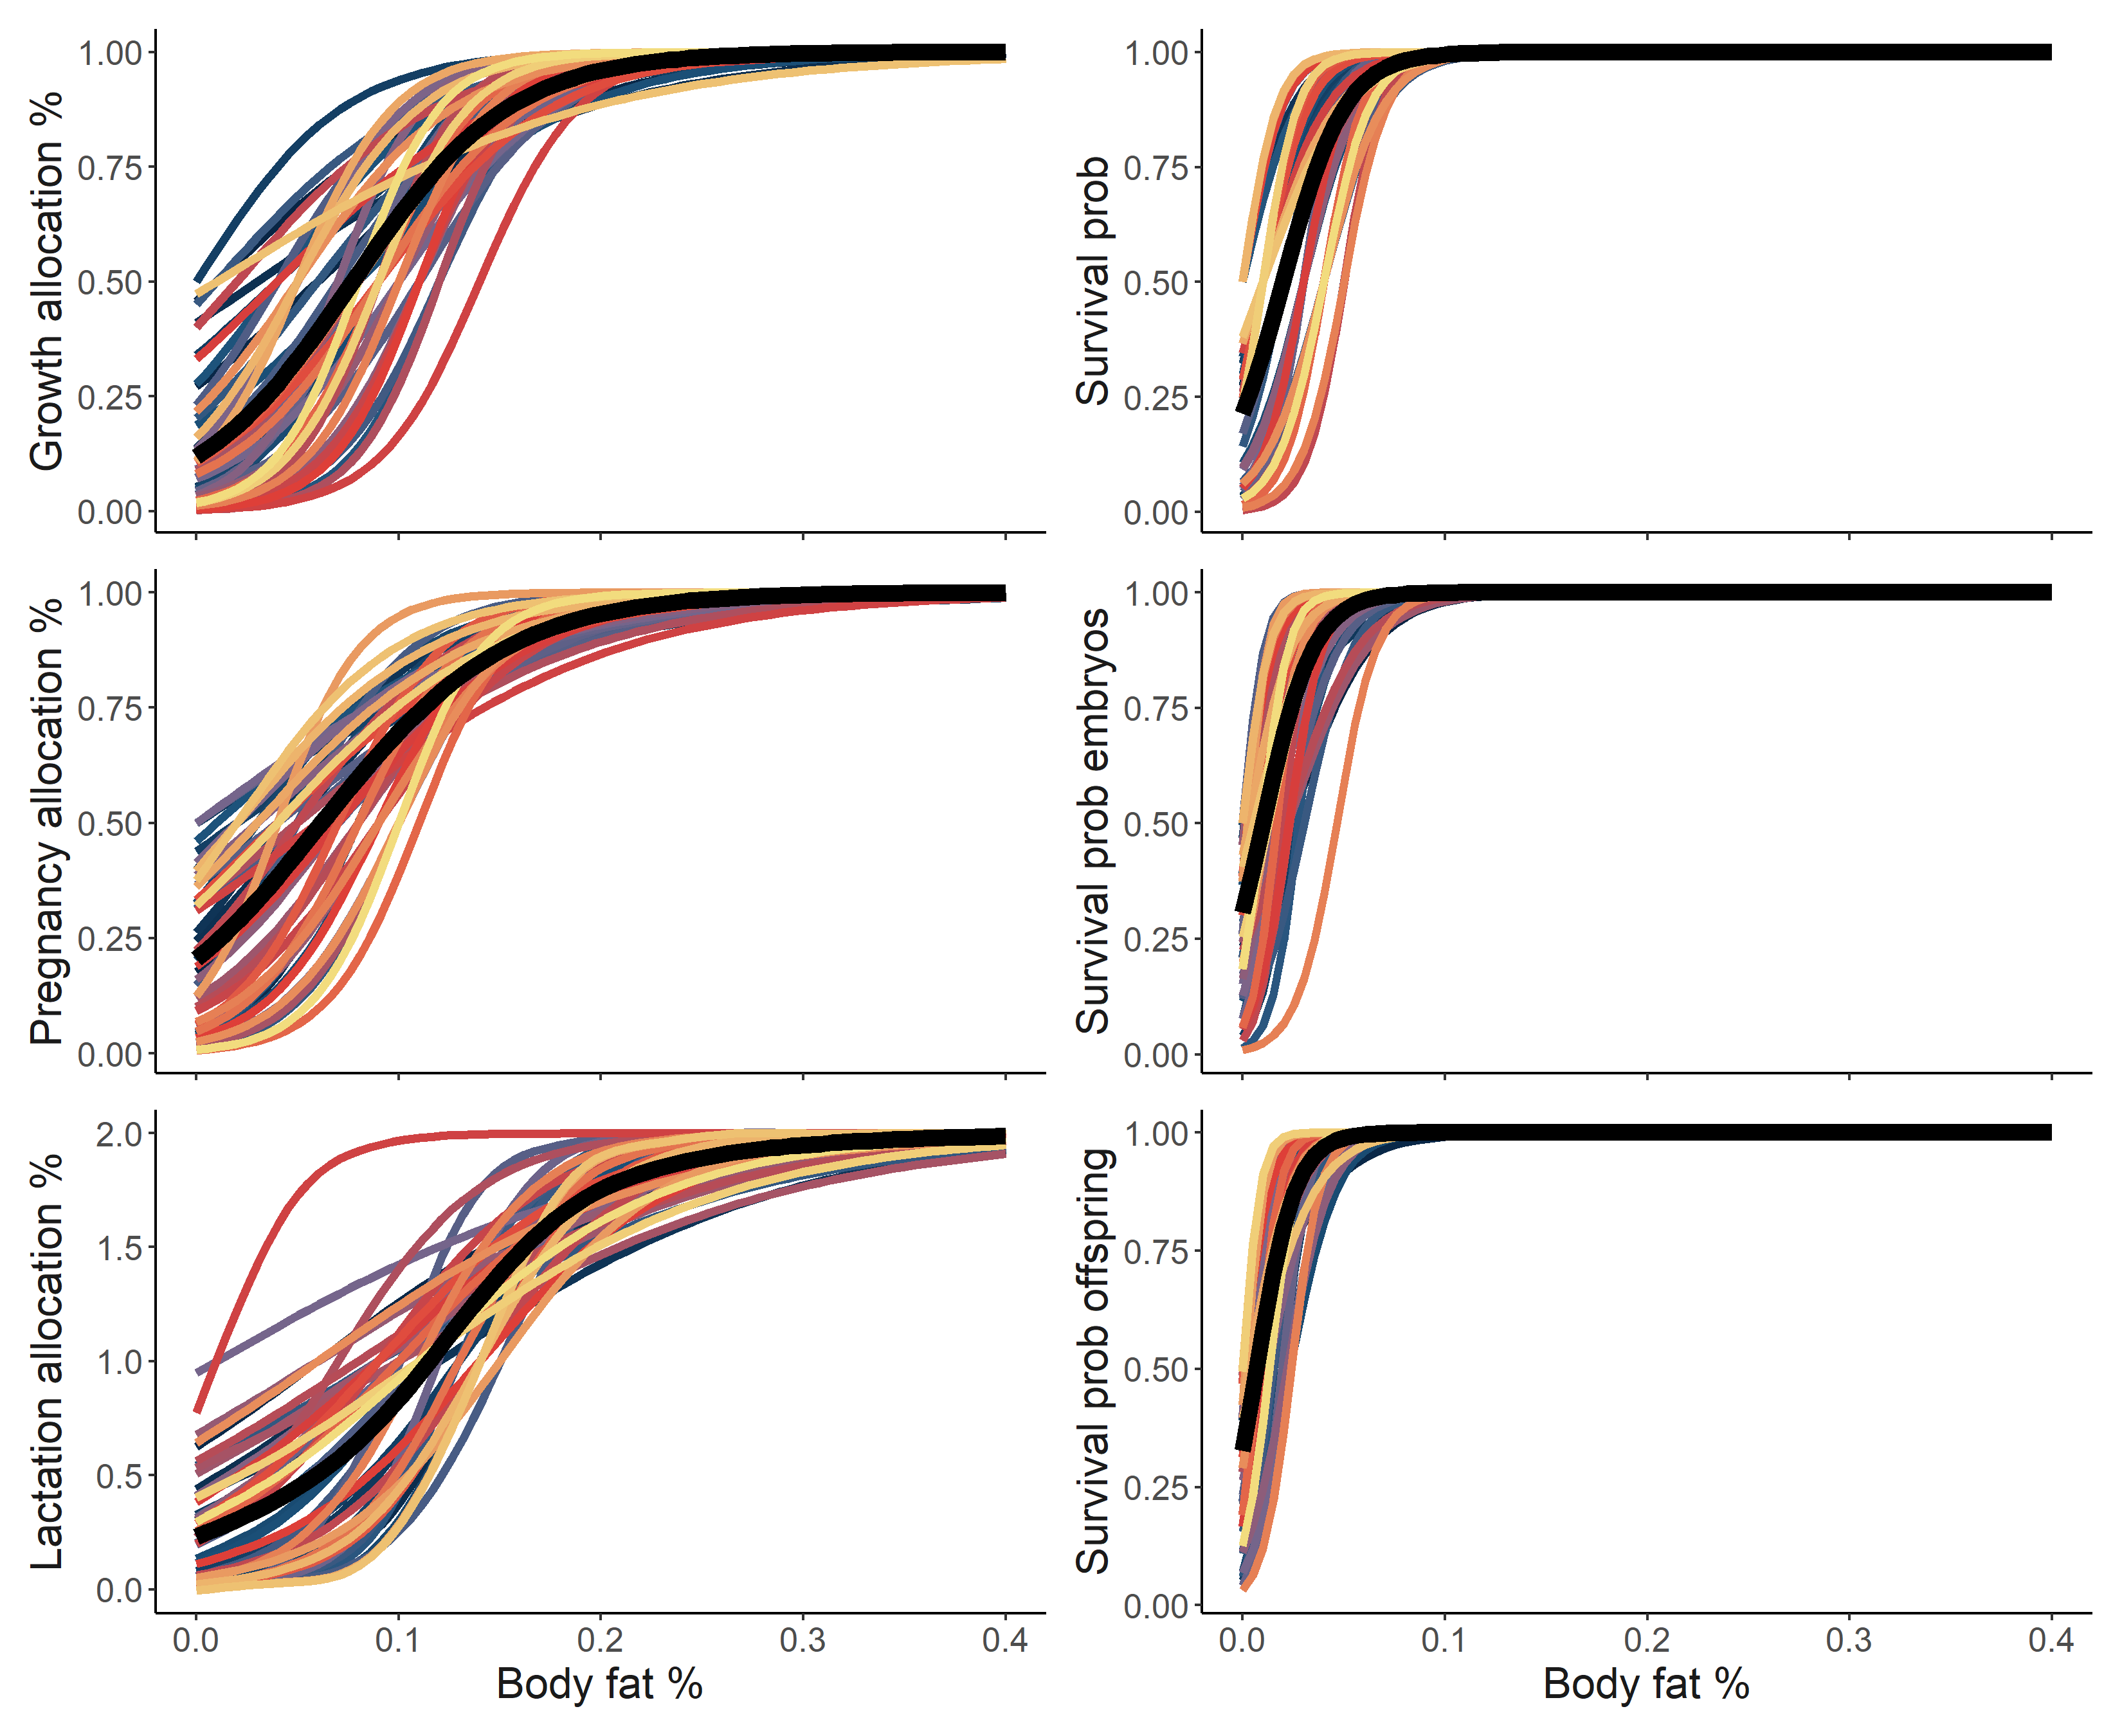
Posterior curves

Slide 10
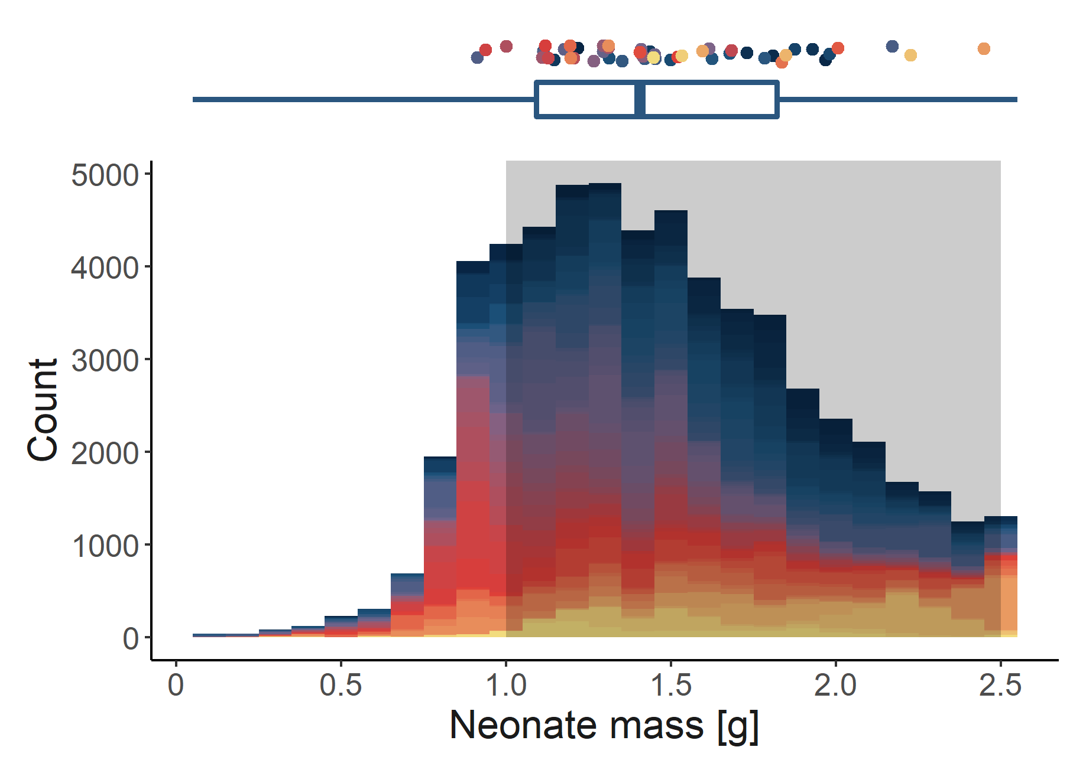
Pattern 1. Fetal mass at birth
Fit to within 1.0 to 2.5 g
(range of newborn masses in Koivula et al. 2003)
Notes:
240 Calories to 1 MJ

Slide 11
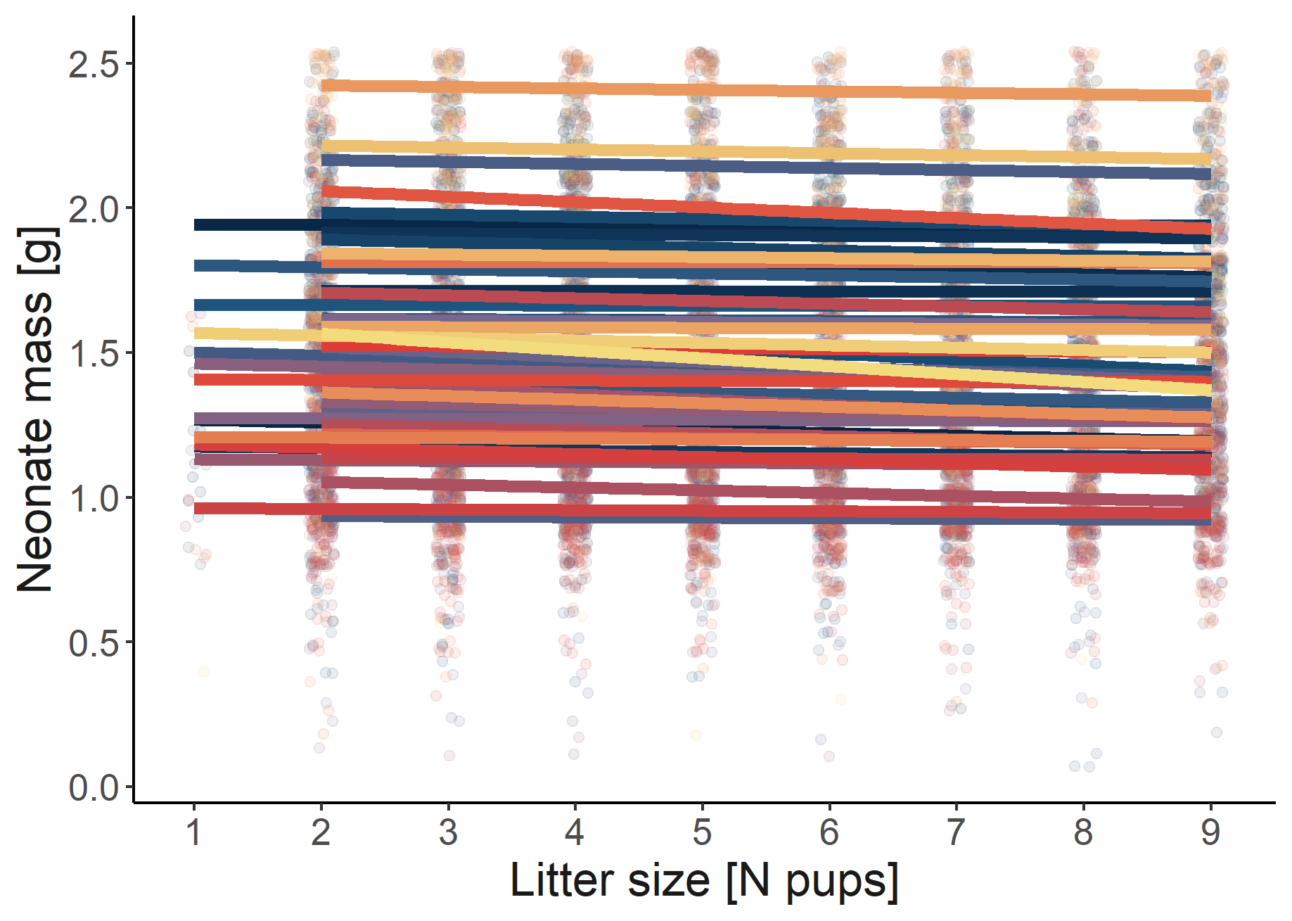
Pattern 2. Birth mass by litter size
A negative relationship
(Mappes and Koskela 2004)
Notes:
240 Calories to 1 MJ

Slide 12
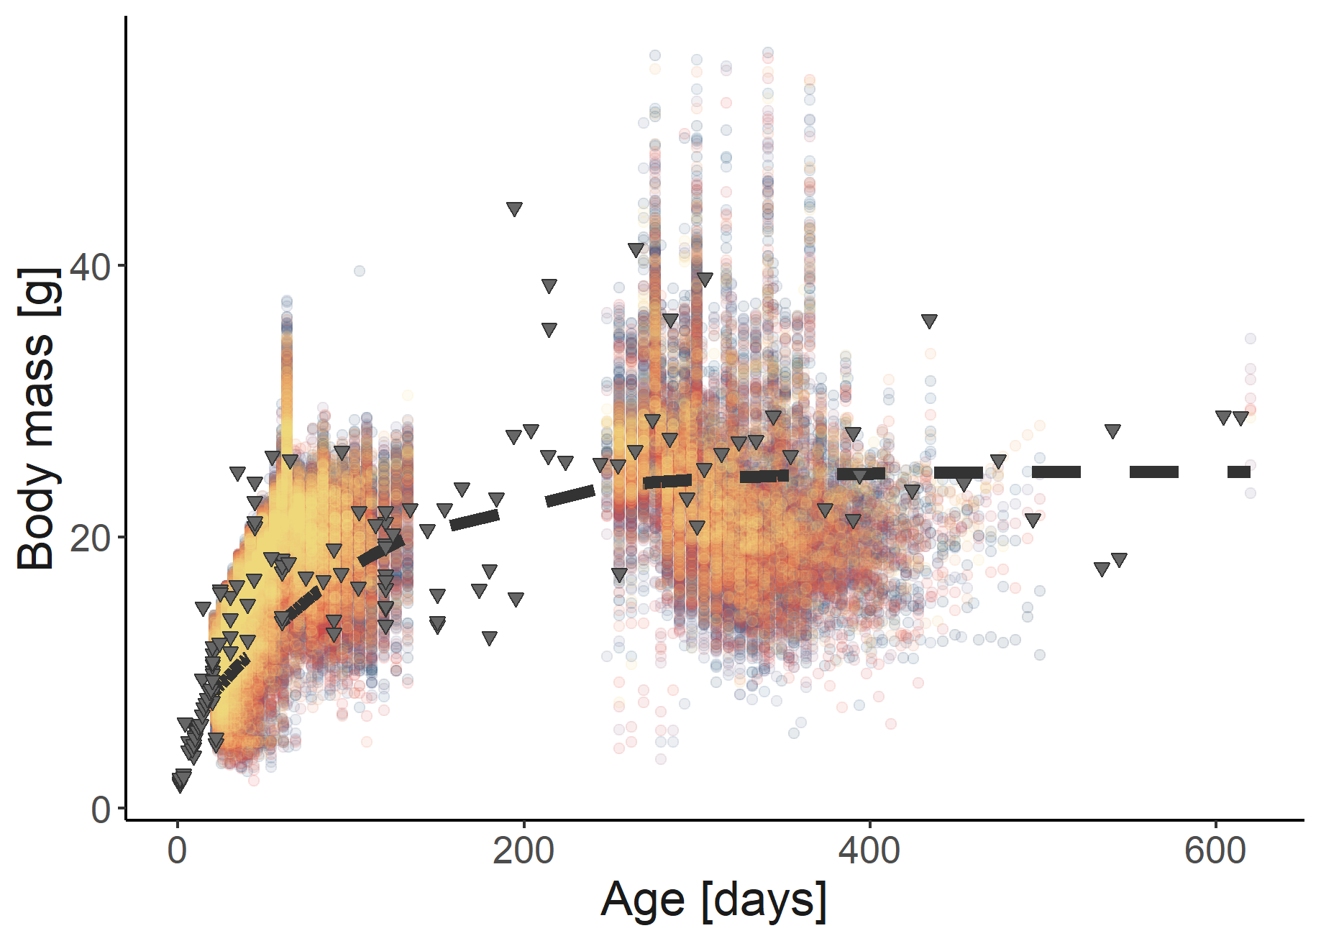
Pattern 3. Total body mass by age
Based on Von Bertalanffy curve fit to data
(Fedyk 1974, Hansson 1991, Rudolf et al. 2017, Sawicka-Kapusta 1974, Balčiauskienė 2007, Gębczyński 1975)
Notes:
240 Calories to 1 MJ

Slide 13
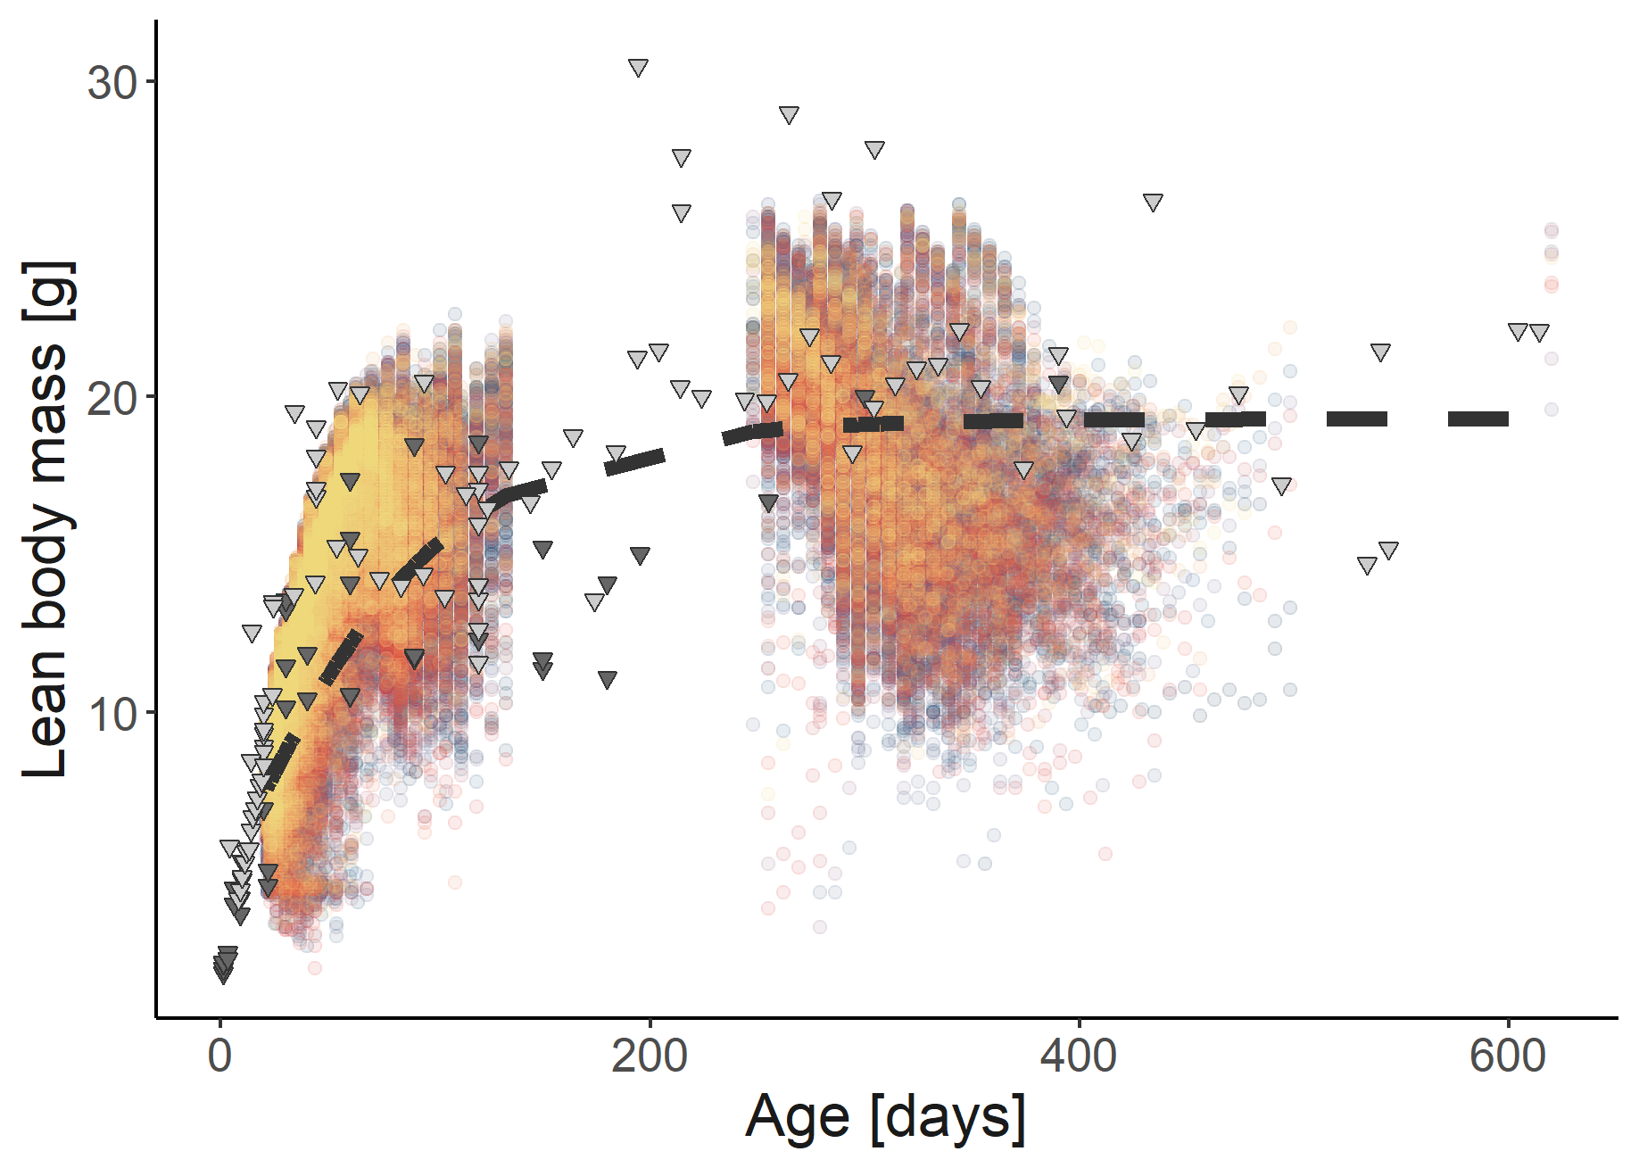
Pattern 4. Lean mass by age
Based on Von Bertalanffy curve fit to data
(some lean masses had to be approximated - in light grey)
(Fedyk 1974, Hansson 1991, Rudolf et al. 2017, Sawicka-Kapusta 1974, Balčiauskienė 2007, Gębczyński 1975)
Notes:
240 Calories to 1 MJ

Slide 14
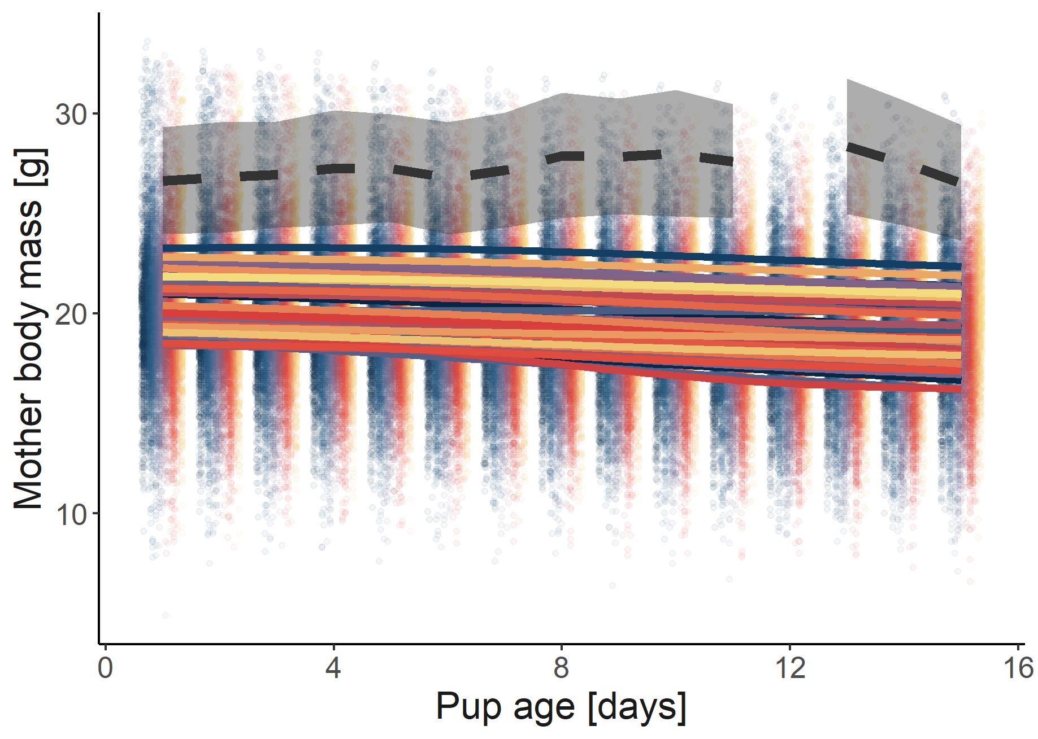
Pattern 5. Mother mass by pup age
Means and standard error pulled directly from plots
(Sadowksa et al. 2016)
Notes:
240 Calories to 1 MJ

Slide 15
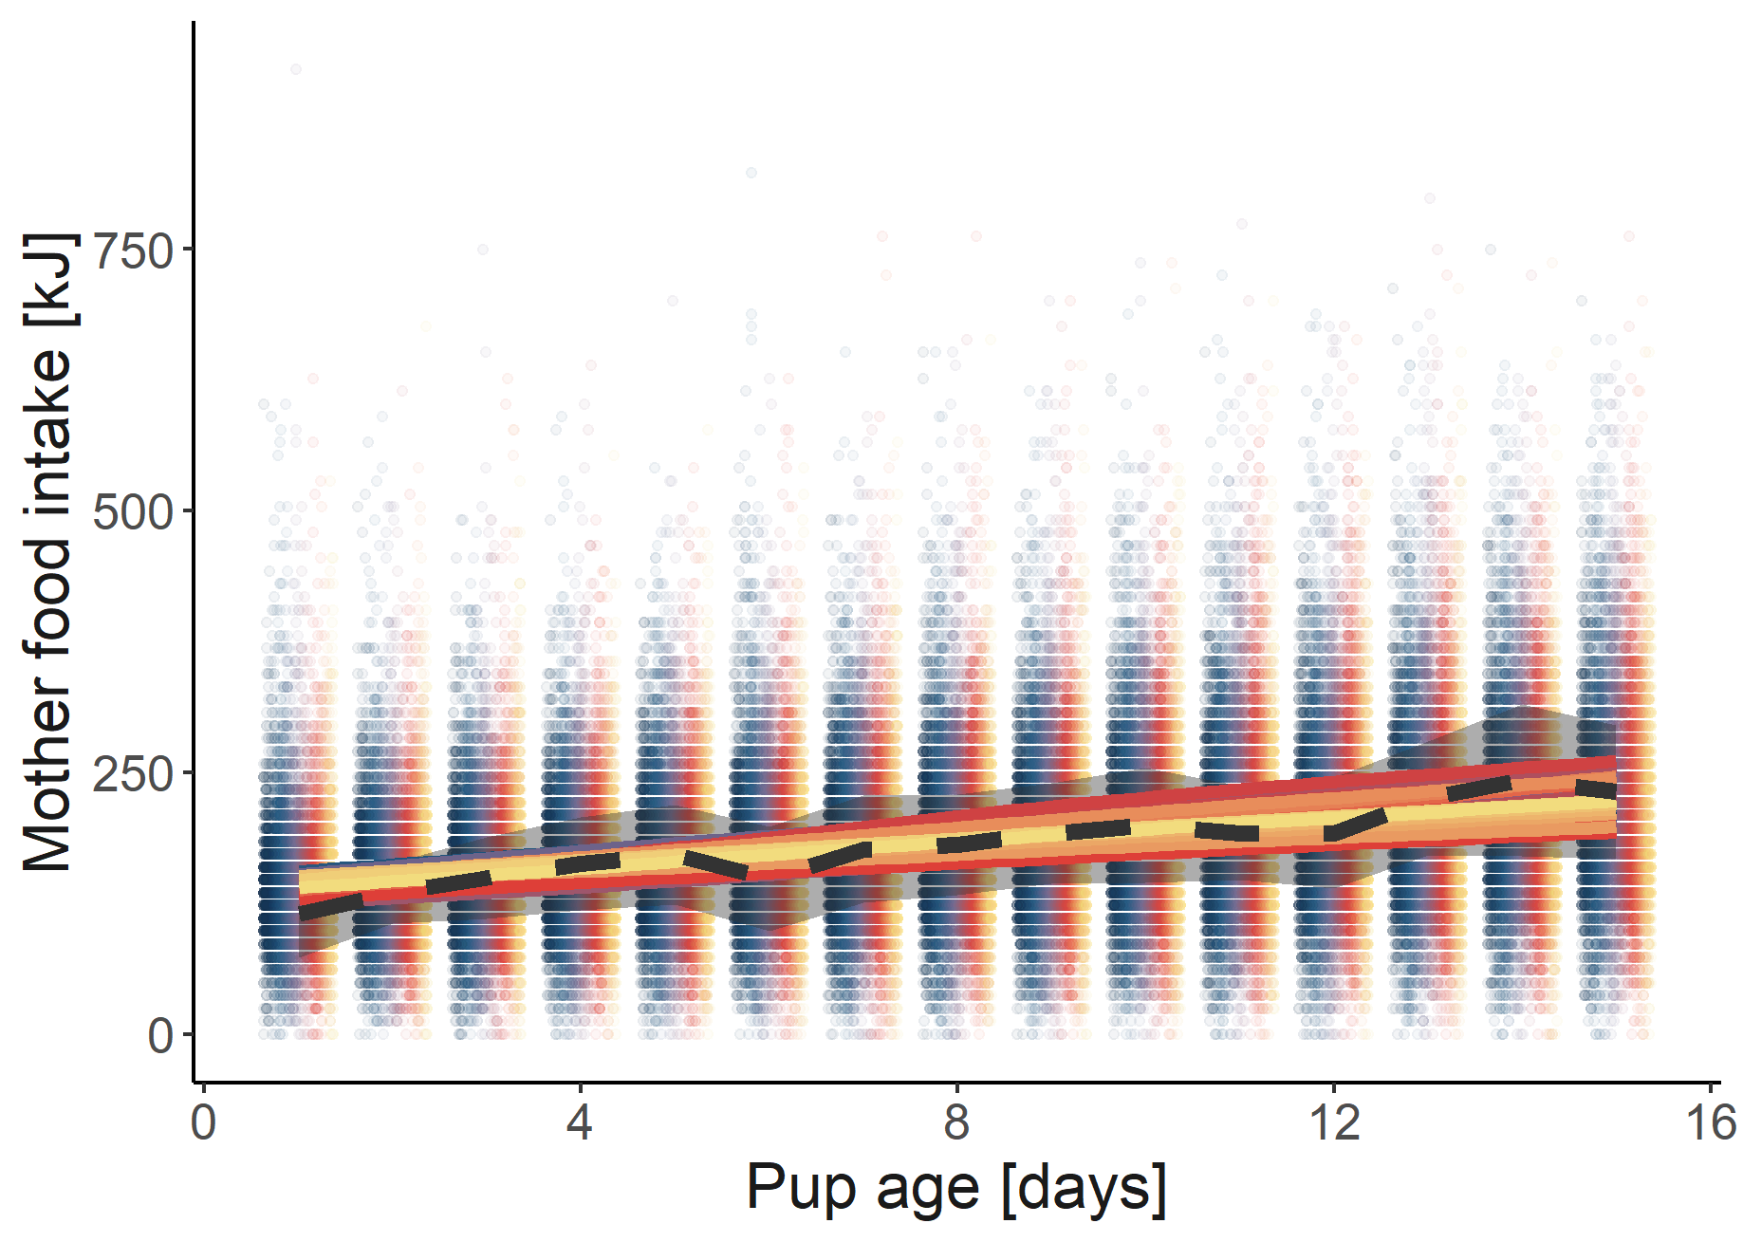
Pattern 6. Mother food intake by pup age
Means and standard error pulled directly from plots
(Sadowksa et al. 2016)
Notes:
240 Calories to 1 MJ

Slide 16
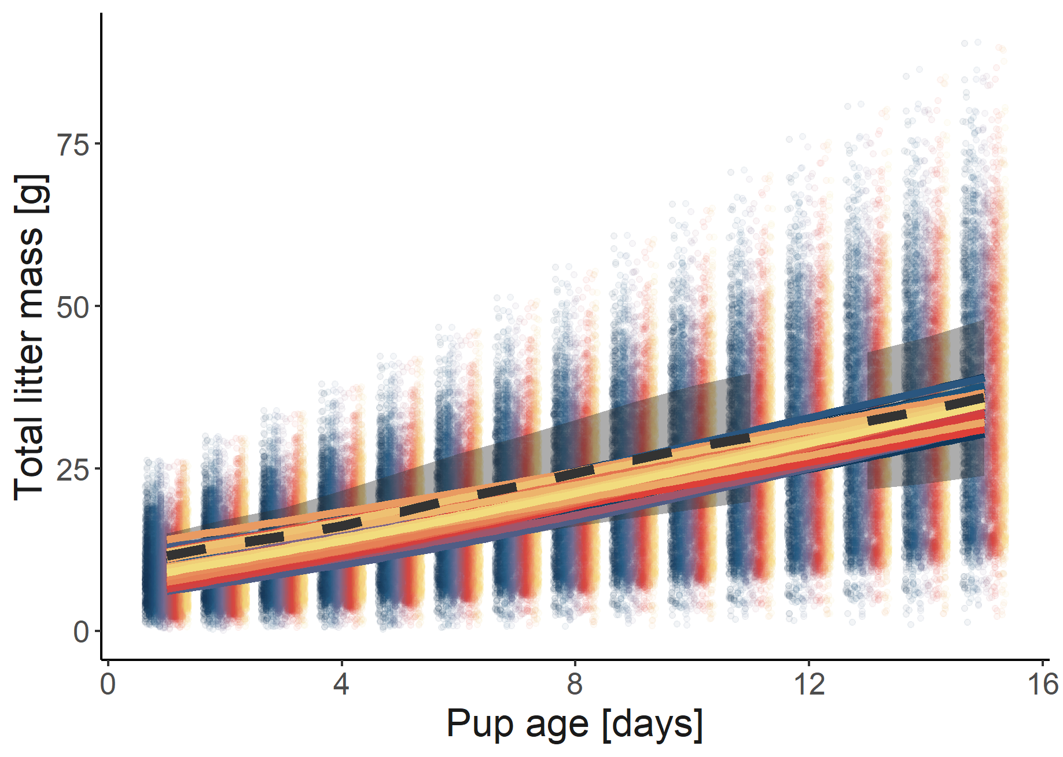
Pattern 7. Total litter mass by pup age
Means and standard error pulled directly from plots
(Sadowksa et al. 2016)
Notes:
240 Calories to 1 MJ

Slide 17
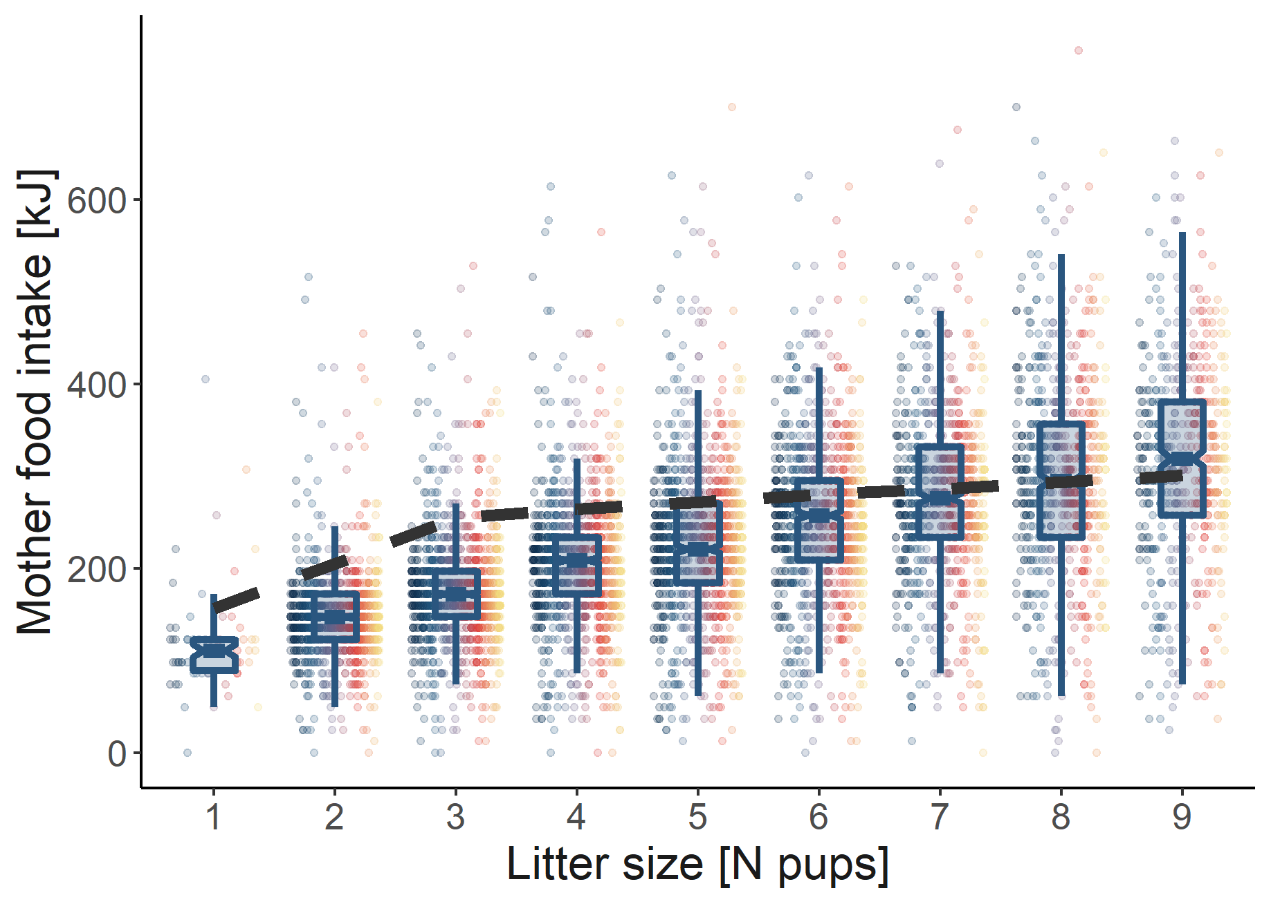
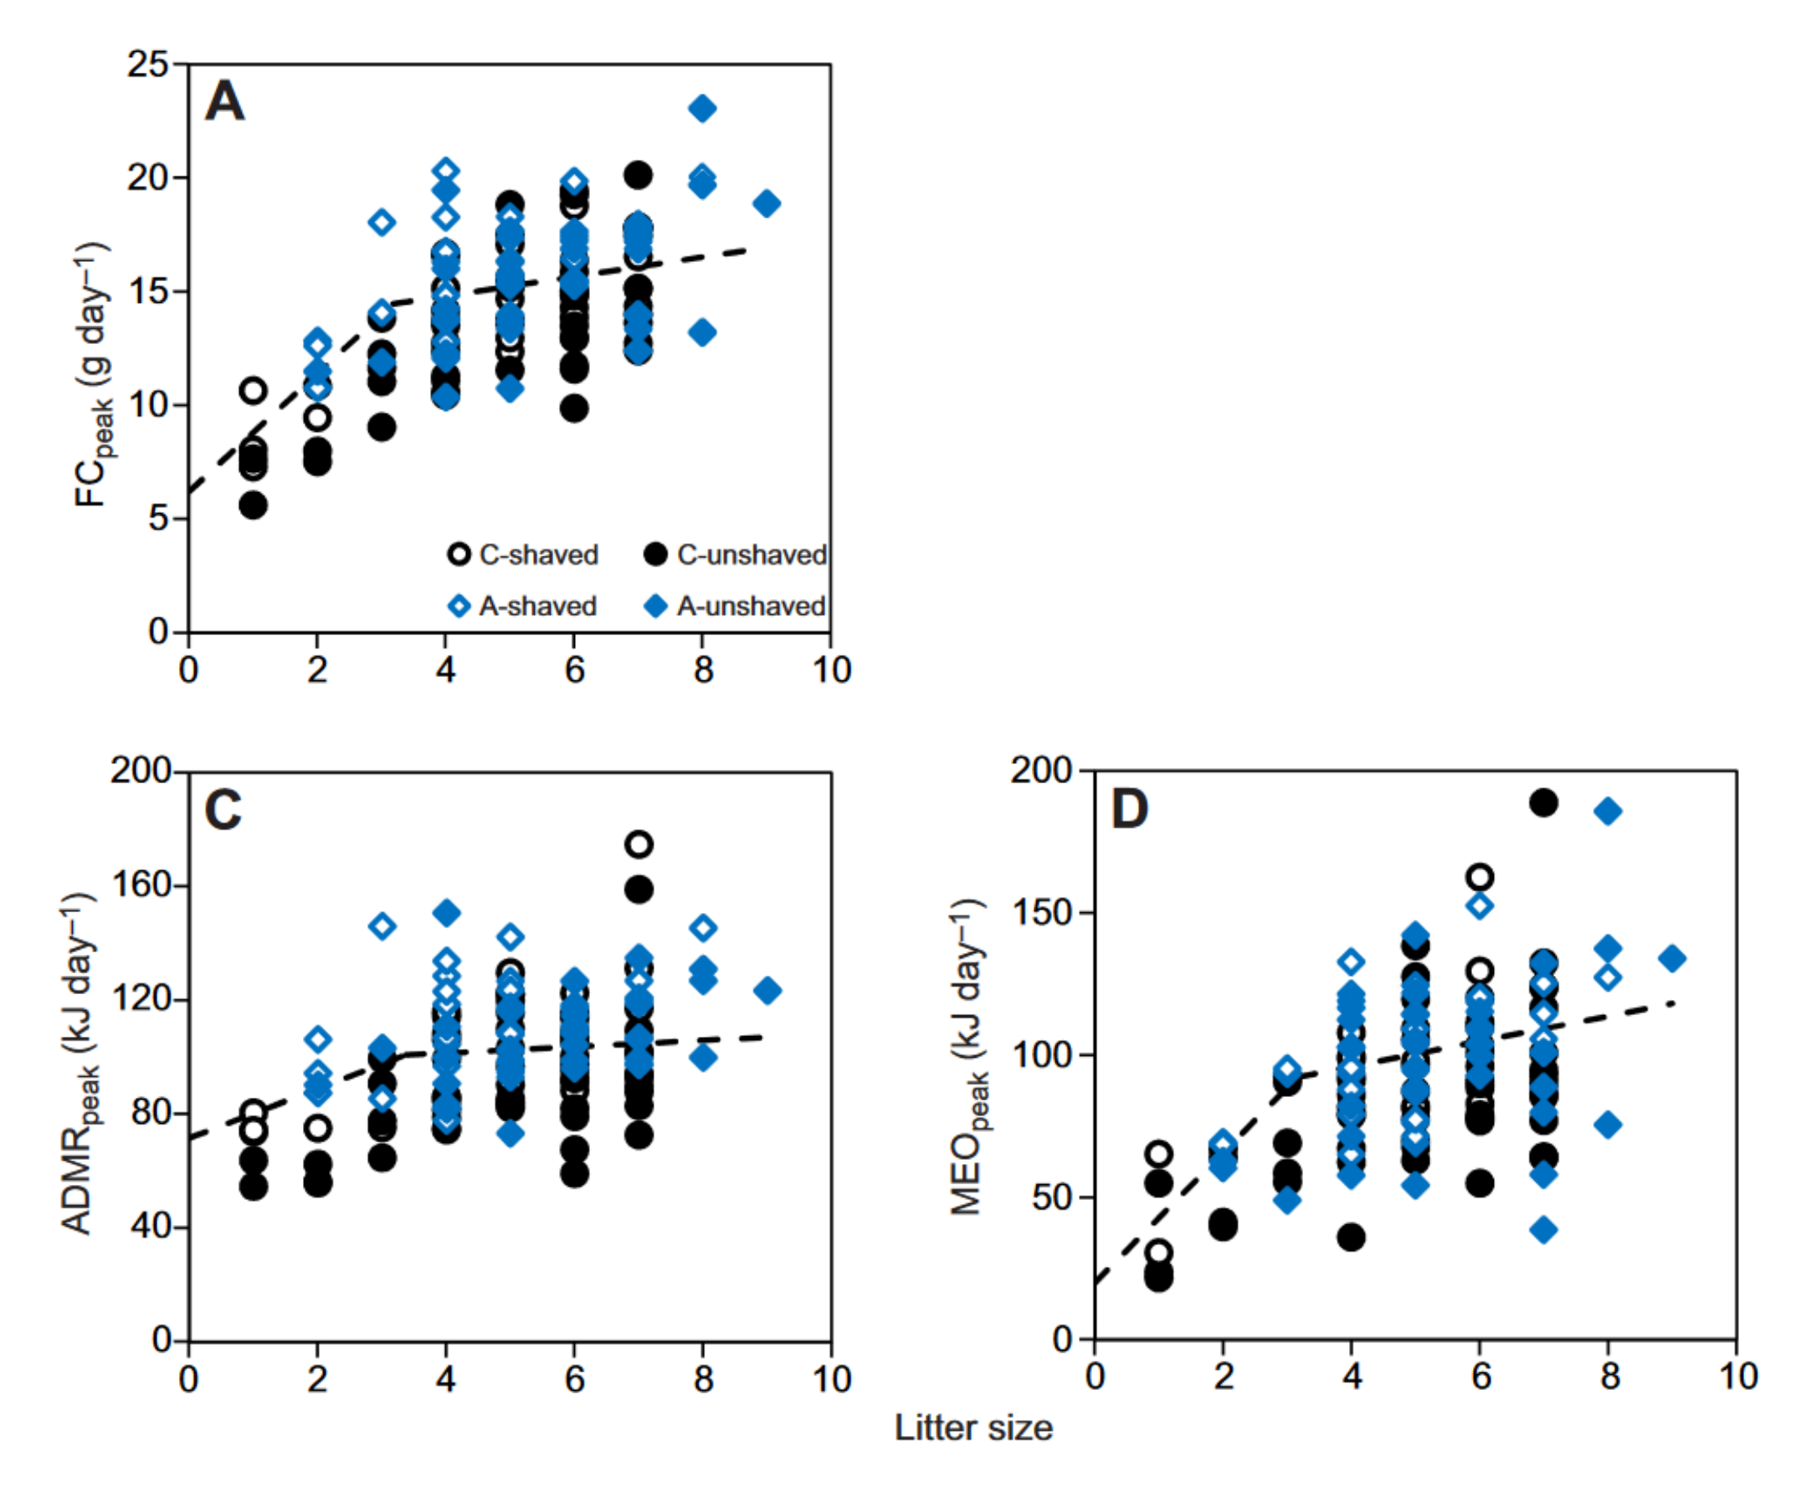
Pattern 8. Mother peak food intake by litter size
Non-linear regression model predictions for a female of average body mass (29.1 g)
(Sadowksa et al. 2016)
For day 15 in the lactation period
Notes:
240 Calories to 1 MJ

Slide 18
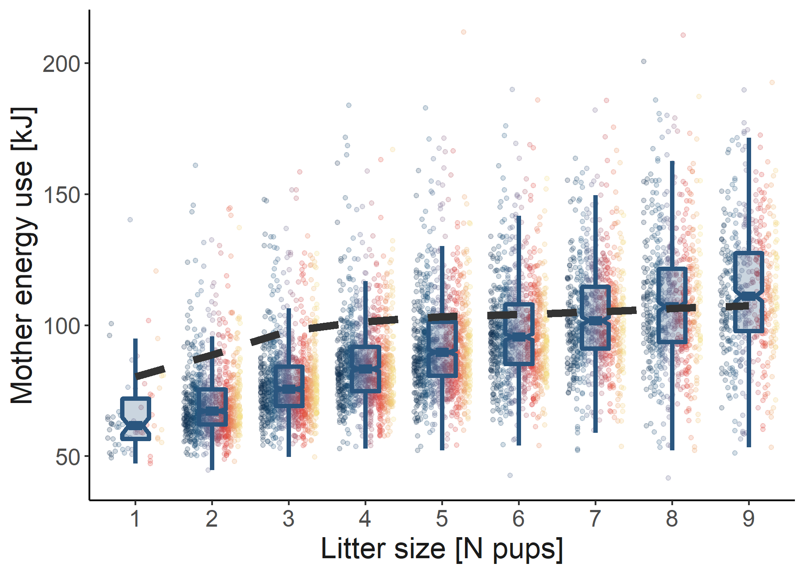
Pattern 9. Mother peak energy use by litter size
Non-linear regression model predictions for a female of average body mass (29.1 g)
(Sadowksa et al. 2016)
For day 15 in the lactation period
Notes:
240 Calories to 1 MJ

Slide 19
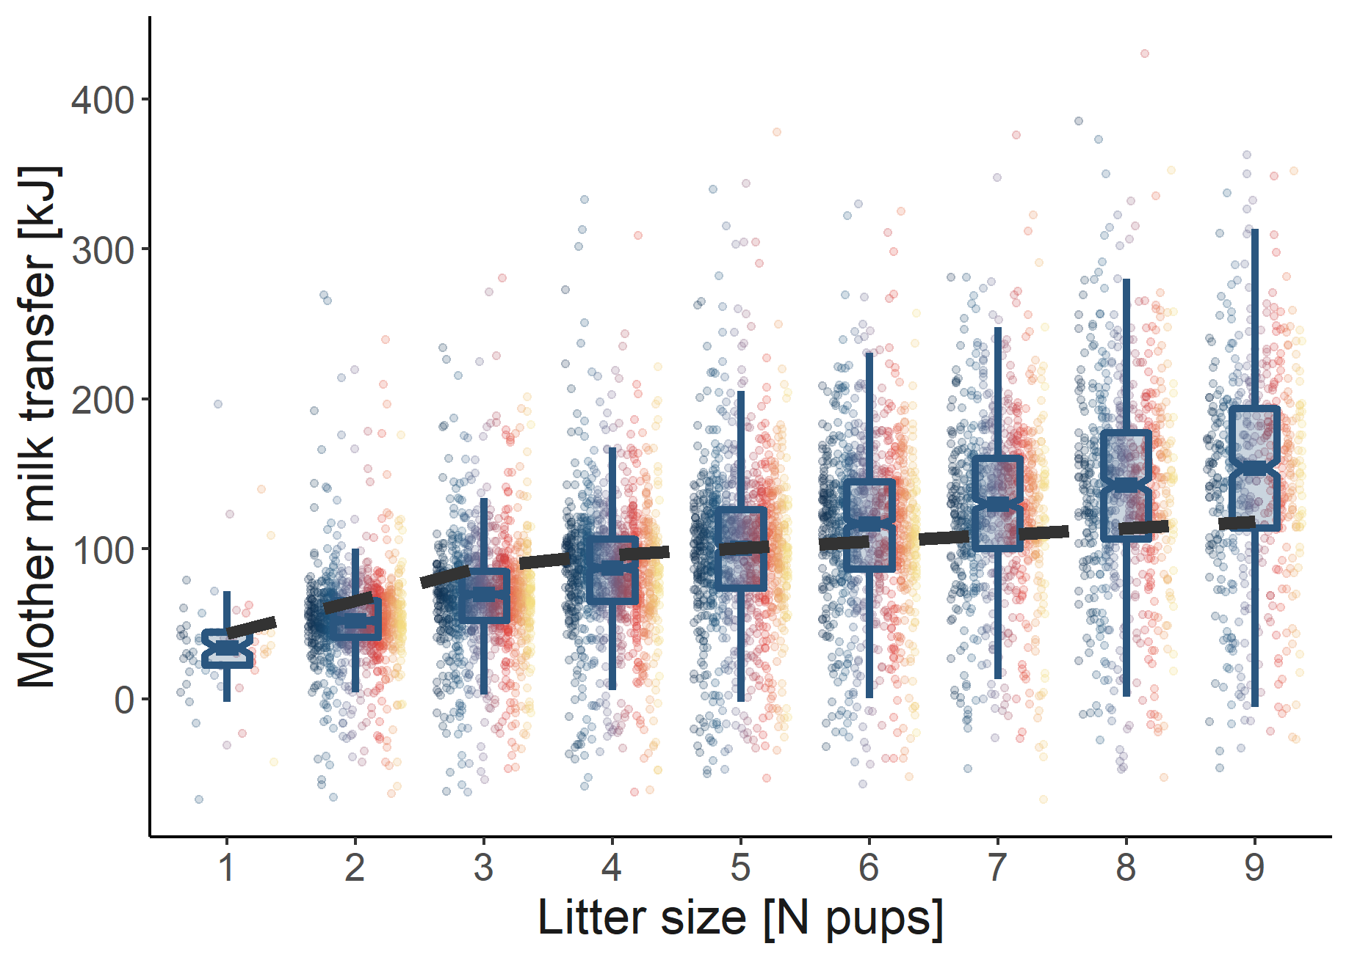
Pattern 10. Mother peak milk transfer by litter size
Non-linear regression model predictions for a female of average body mass (29.1 g)
(Sadowksa et al. 2016)
For day 15 in the lactation period
Notes:
240 Calories to 1 MJ

Slide 20
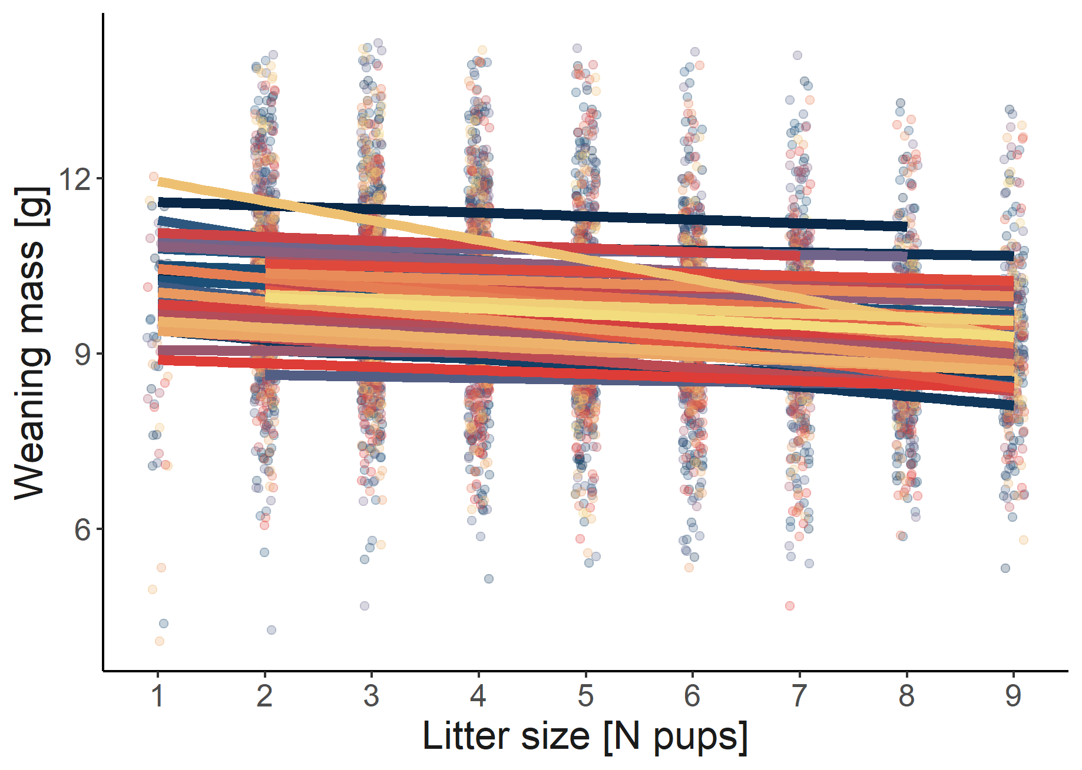
Pattern 11. Pup mass at weaning by litter size
A negative relationship
(Oksanen et al. 2001, Sievert et al. 2021)
Notes:
240 Calories to 1 MJ

Slide 21
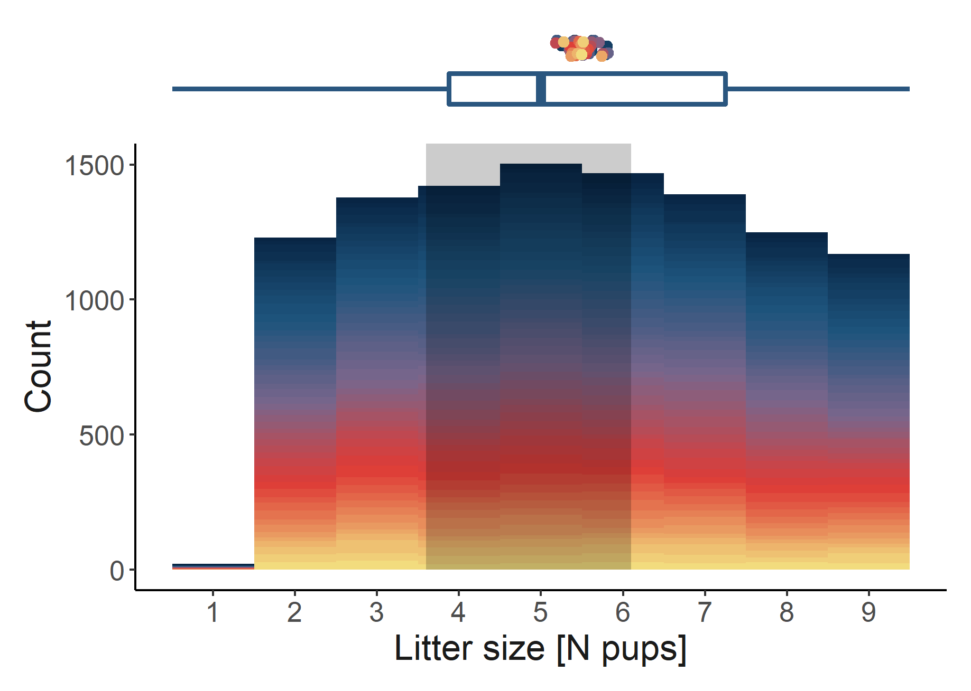
Pattern 12. Litter size at birth
Average between 3.6 – 6.1 pups
(Bujalska & Ryszkowski 1966, Koivula et al. 2003, Kaczmarski 1966, Bujalska & Ryszkowski 1966, Drożdż, 1963, Brambell & Rowlands, 1936, Naumov 1948, Popov 1960, Zejda 1966, Buchalczyk 1970, Sadowska et al. 2016)
Notes:
240 Calories to 1 MJ

Slide 22
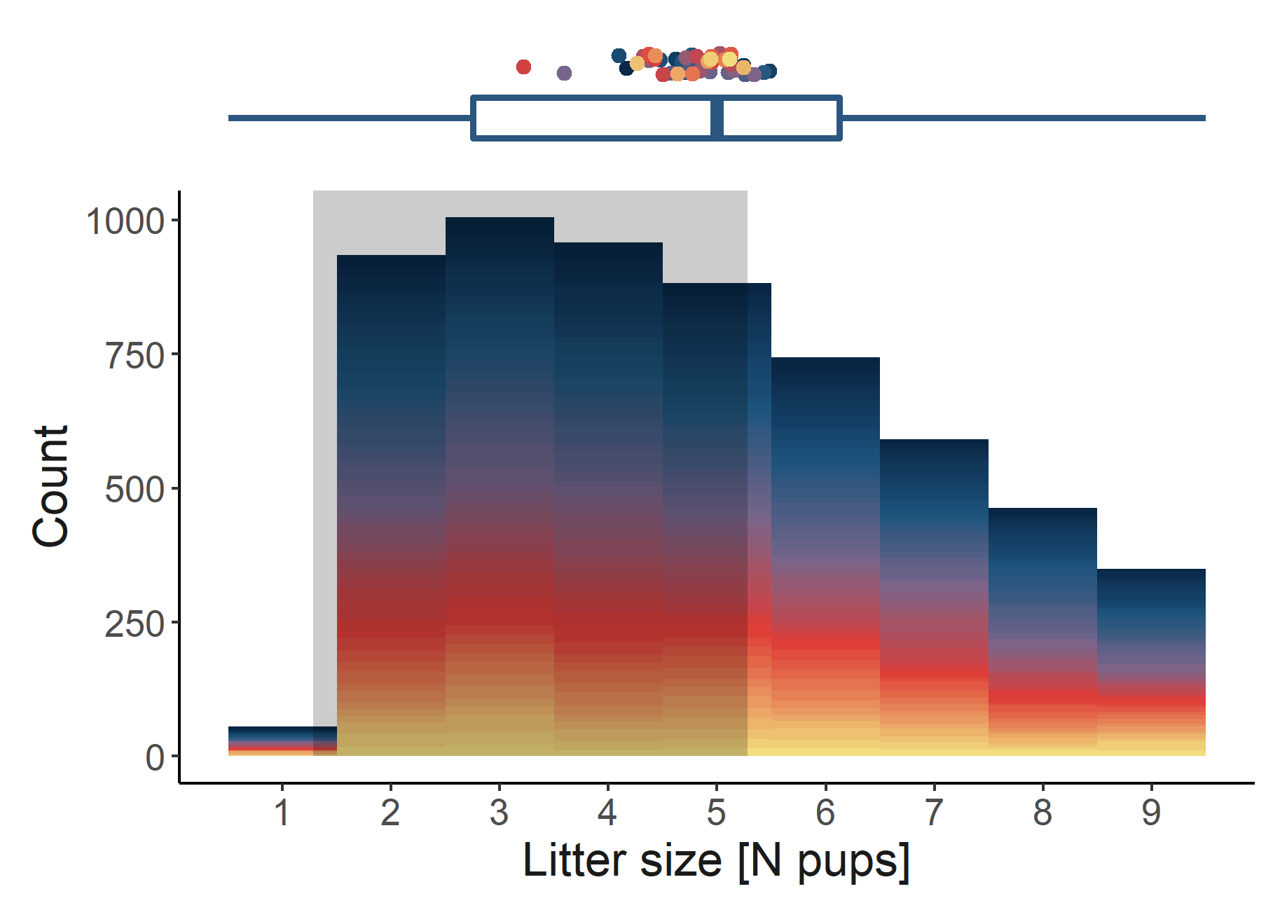
Pattern 13. Litter size at weaning
Average between 1.28 – 5.28 pups
(Kaczmarski 1966, Koivula et al. 2003, Koskela 1998, Koskela et al. 1998, Mappes et al. 1995, Ołdakowski et al. 2015, Ołdakowski et al. 2012)
Notes:
240 Calories to 1 MJ

Slide 23
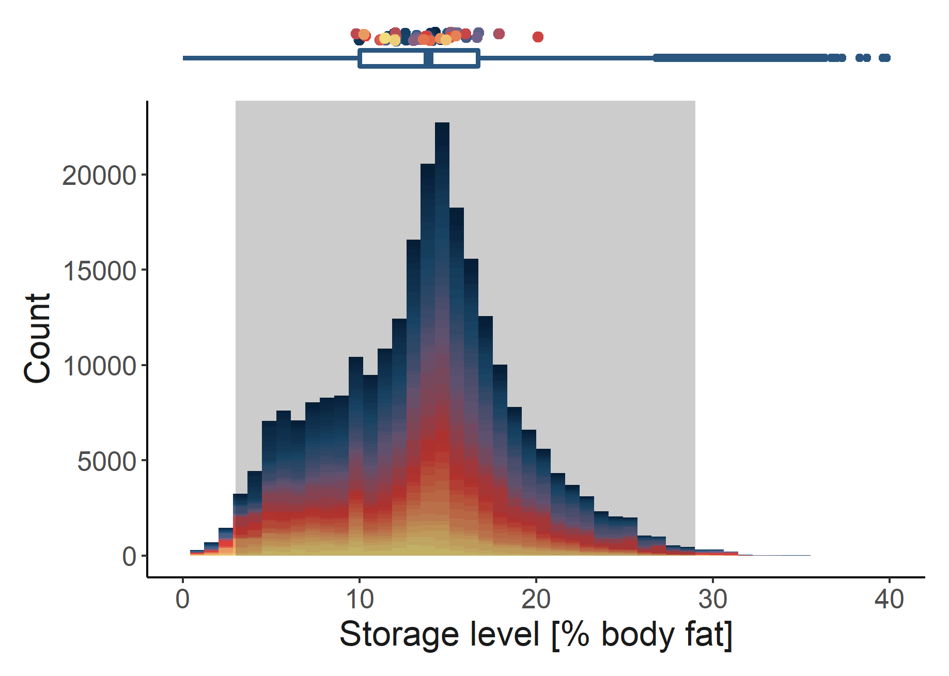
Pattern 15. Body condition of living animals
Range between 3 – 29% body fat
(Fedyk 1974, Sawicka-Kapusta 1974, Tidhar and Speakman 2007)
Notes:
240 Calories to 1 MJ

Slide 24
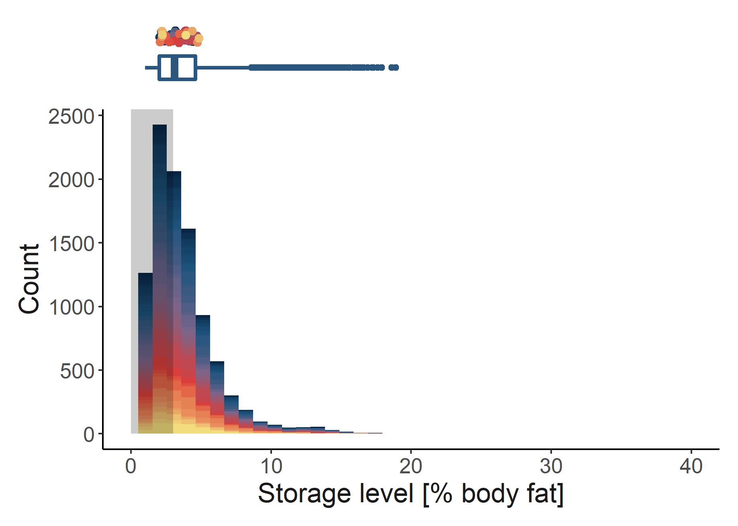
Pattern 16. Body condition at death
Lowest observed value in empirical data of living animals (3% body fat)
(Fedyk 1974, Sawicka-Kapusta 1974, Tidhar and Speakman 2007)
Notes:
240 Calories to 1 MJ

Slide 25
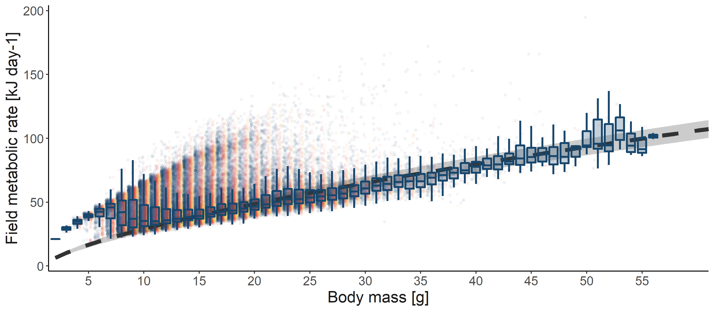
Pattern 17. Field metabolic rate by body mass
Used two allometric curves for rodents
(King 1974, Nagy, Girard, & Brown 1999)
Notes:
240 Calories to 1 MJ

Slide 26
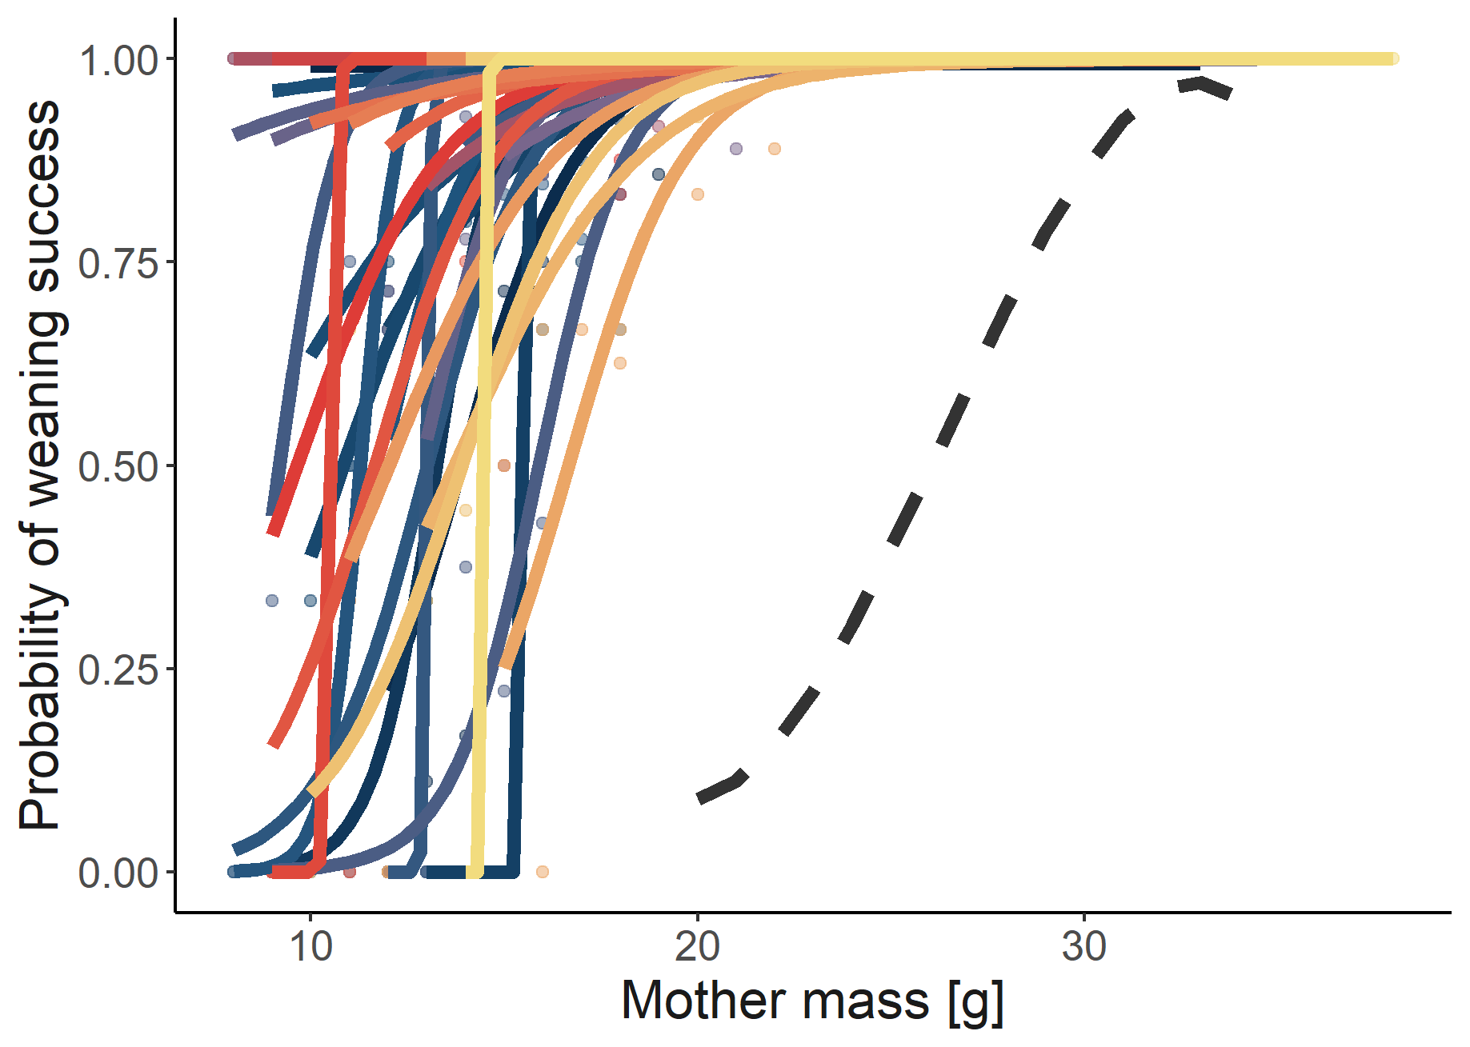
Pattern 14. Probability of weaning by mother body mass
Based on logistic function
(Jonsson et al. 2002)
Average adult mass from the model, Pantheria database, and other sources
Notes:
240 Calories to 1 MJ

Slide 27
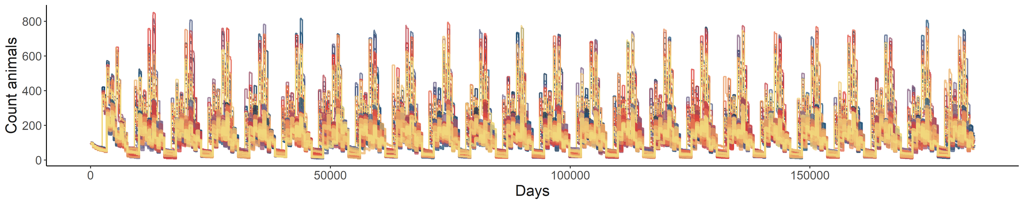
Population dynamics
Notes:
240 Calories to 1 MJ

Slide 28
Next steps
Get your thoughts and see if you are happy with these results
Sensitivity analysis
Evaluation patterns
Prepare scenarios
Finish ODD & documentation
Get to running & writing!

Slide 29
First application
DEE
Mass
Notes:
240 Calories to 1 MJ

Slide 30
First application
How does the environment shape the evolution of different metabolic phenotypes?
The food habits hypothesis identifies 3 dietary components that can drive average and variability of metabolic rates:
Quality, Availability, and Predictability
Bozinovic et al. 2007
Notes:
“….the evolution of a low mass-independent BMR is likely to occur in habitats where food availability is low and/ or unpredictable (McNab 2002; Cruz-Neto and Jones 2005)”

Slide 31
First application
How does the environment shape the evolution of different metabolic phenotypes?
Introduce variation in and heritability of three metabolic traits:
Maintenance costs
Energy allocation to growth
Energy allocation to reproduction
Separate to account for different management models (Careau & Garland 2012, Glazier 2015)
Other approaches instead link these processes

Slide 32

First application
How does the environment shape the evolution of different metabolic phenotypes?
Maintenance costs
Energy allocation to growth
Energy allocation to reproduction
BMR
Allocation %
Allocation %
Body mass
Body fat %
Body fat %

Slide 33
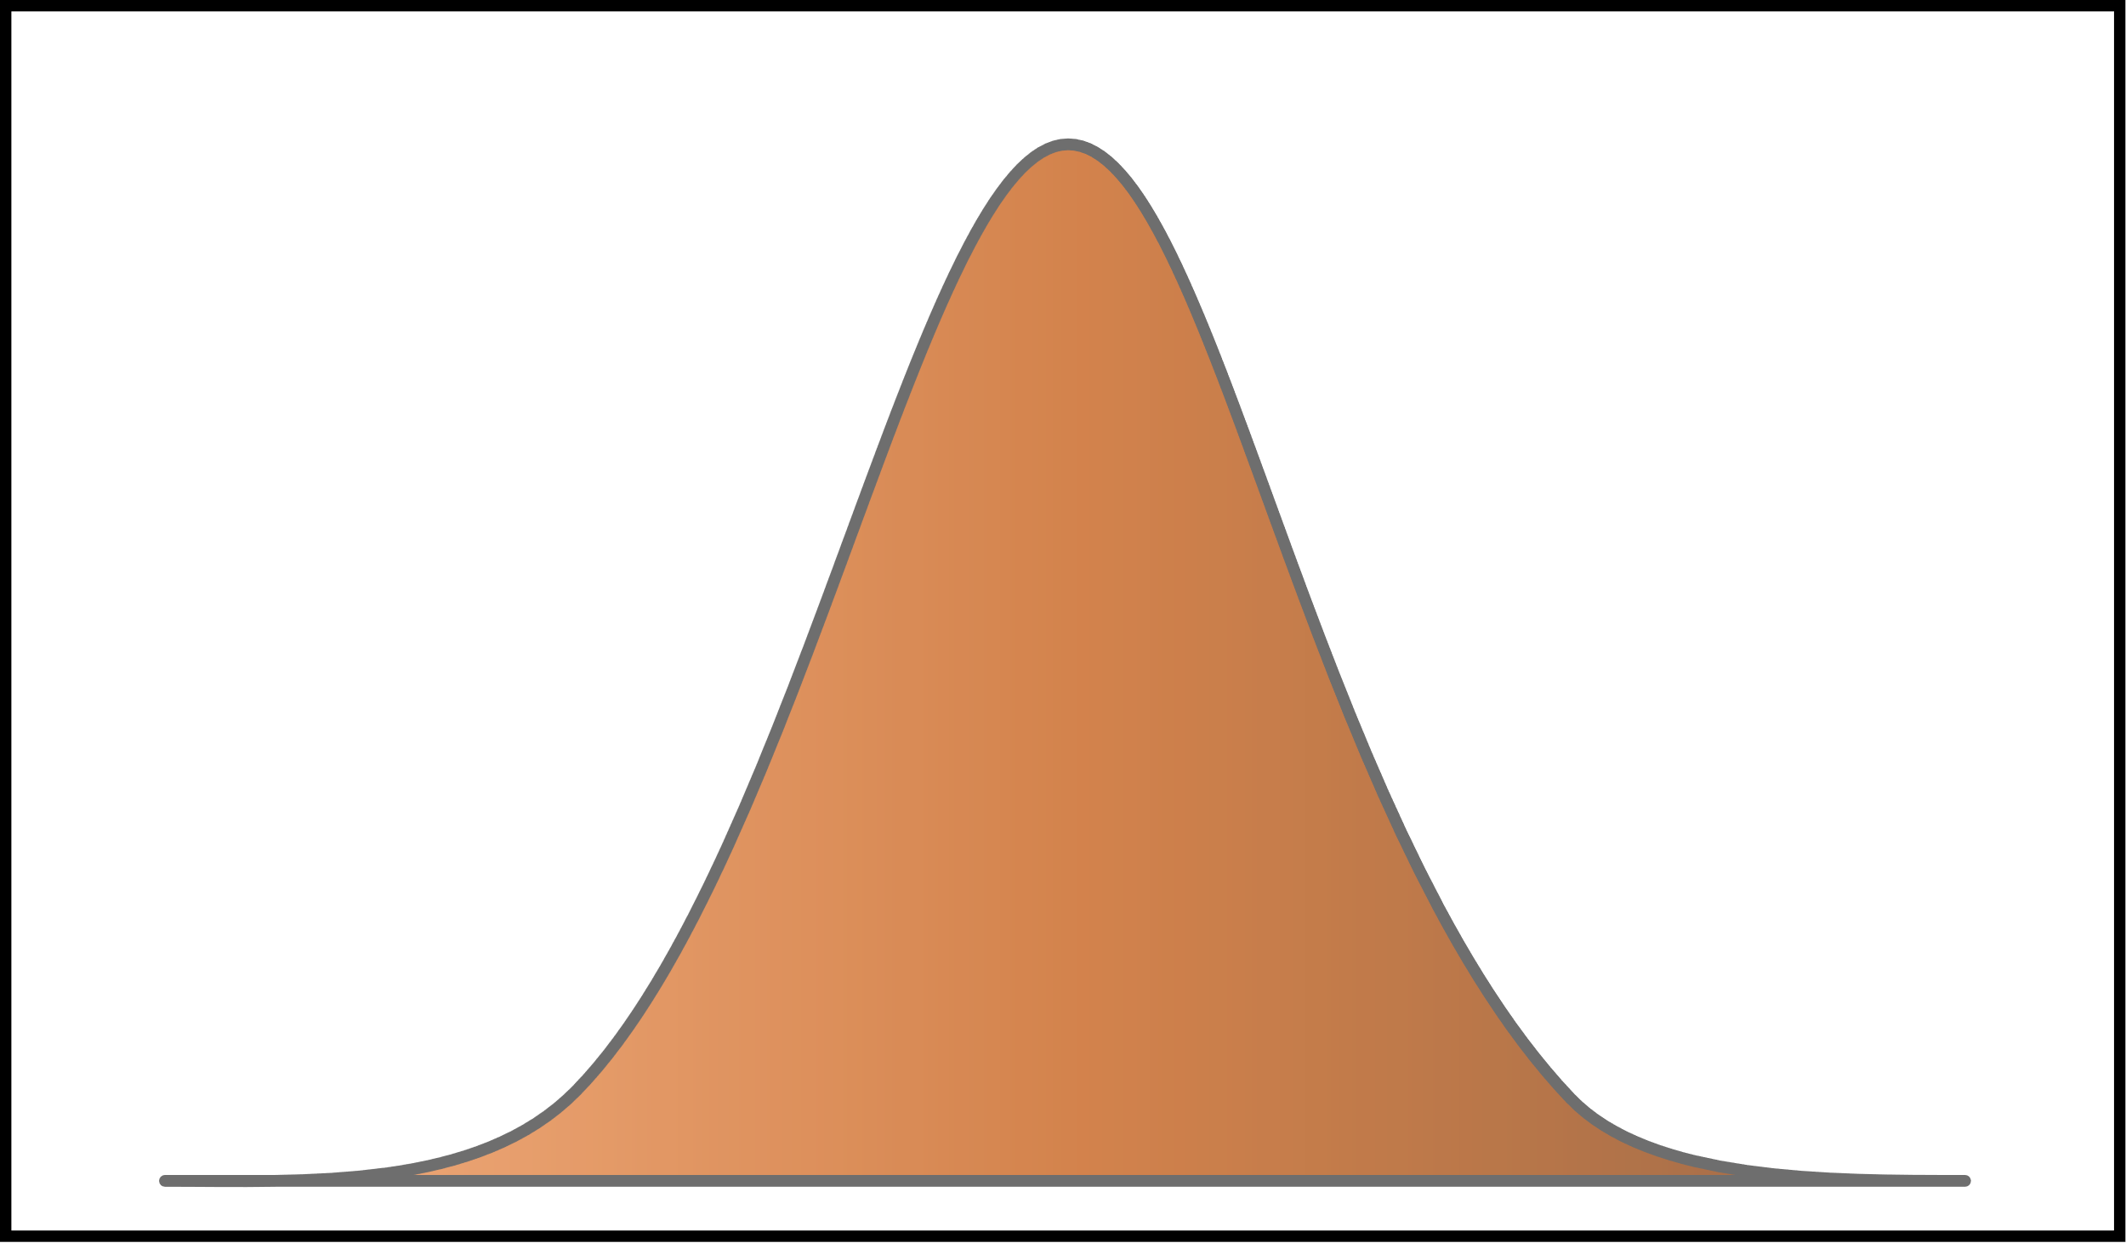
Inheritance
BMR modifier
Probability
Mother’s value
Variance
Based on Milles et al. 2022

Slide 34




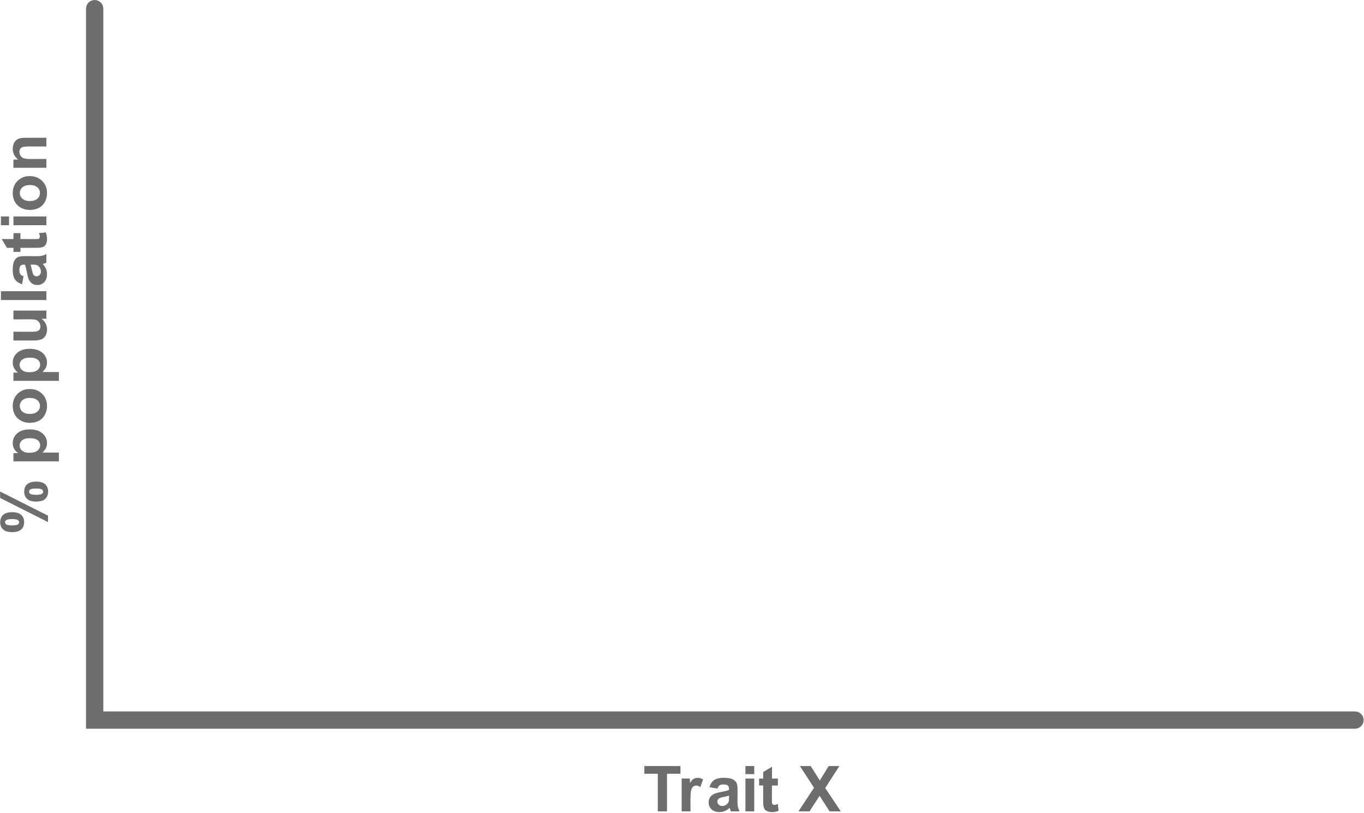
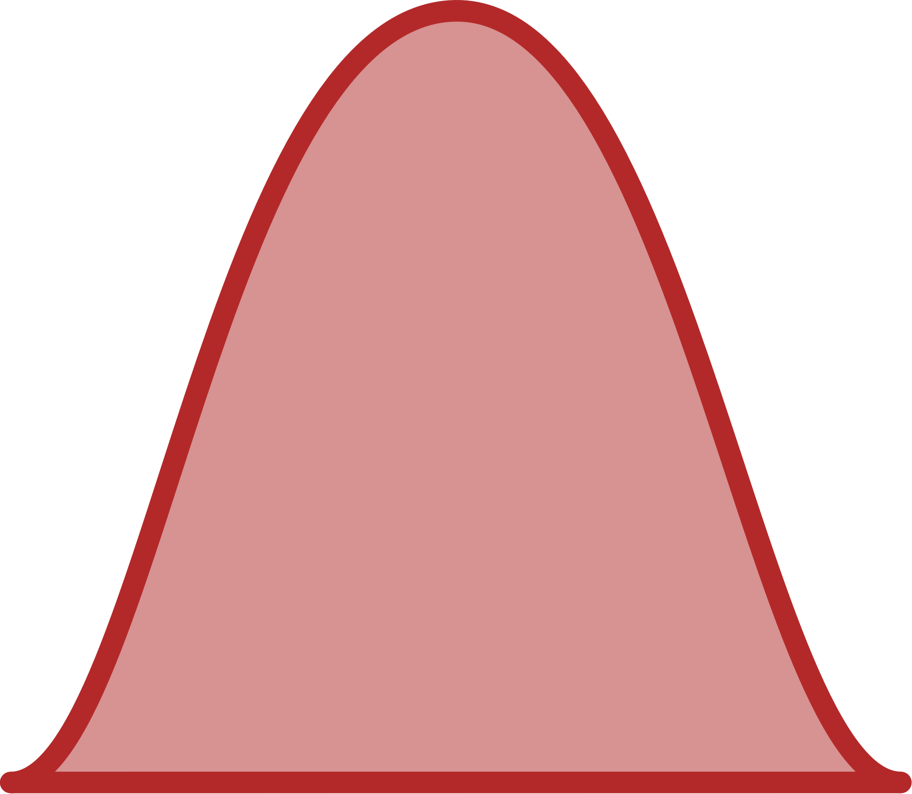
How does the environment shape the evolution of different metabolic phenotypes?
Notes:
Can test things like how the rate of change affects success, long term versus short term environmental changes, combine with other stressors like predation, etc.

